Slide 1
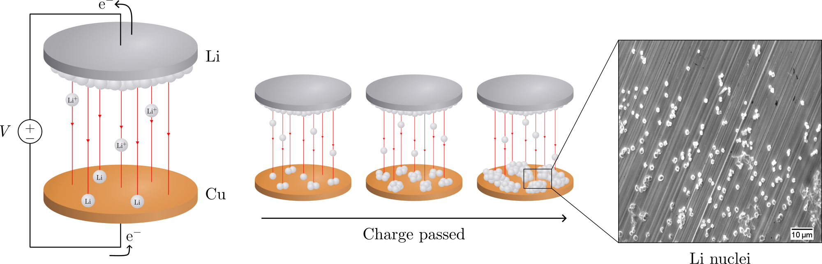
Electrochemical deposition of lithium on copper
Gottfrid Olsson
2024-05-29

Slide 2
PLAN: 25 minute presentation
Introduction:
Importance of batteries, improvements LMB>LIB (fig.), problems non-uniform growth (fig + in-depth), purpose of this thesis
Theory:
Homogenous nucleation theory; main results (fig.), how does eta impact r and N (fig.)?
Methods:
Cell assemblies (note importances; wave spring, no pressure); cycling protocol (fig.)
Results:
passivation of Cu; J-dep.; pressure (C-cell and T-cell, r & angle dep. and morphology)
Conclusion: 2 min
Passivation, J-dep. and pressure to achieve uniform deposition in LMBs
(Opposition and Questions from audience)

Slide 3
Batteries!

Slide 4
Batteries!
250 Wh kg^{–1} to 440 Wh kg^{–1}
600 Wh L^{–1} to 1200 Wh L^{–1}

Slide 5
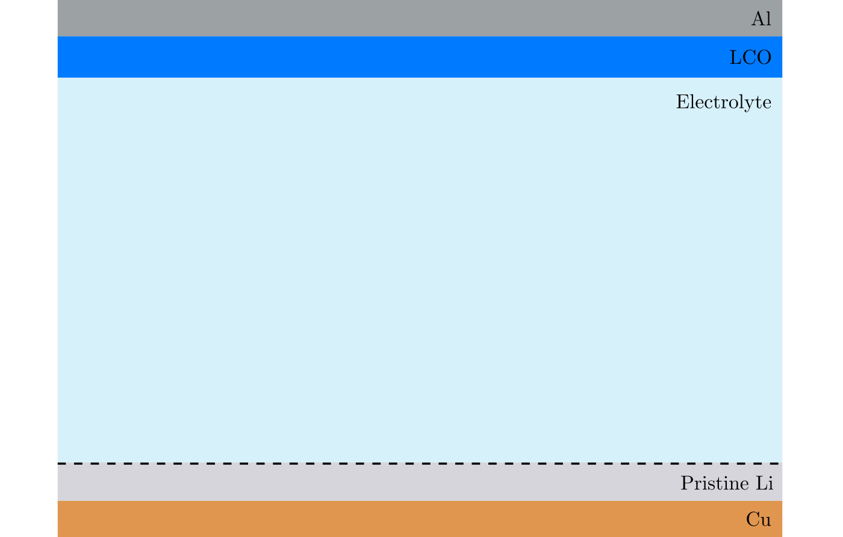
Non-uniform deposition problems

Slide 6
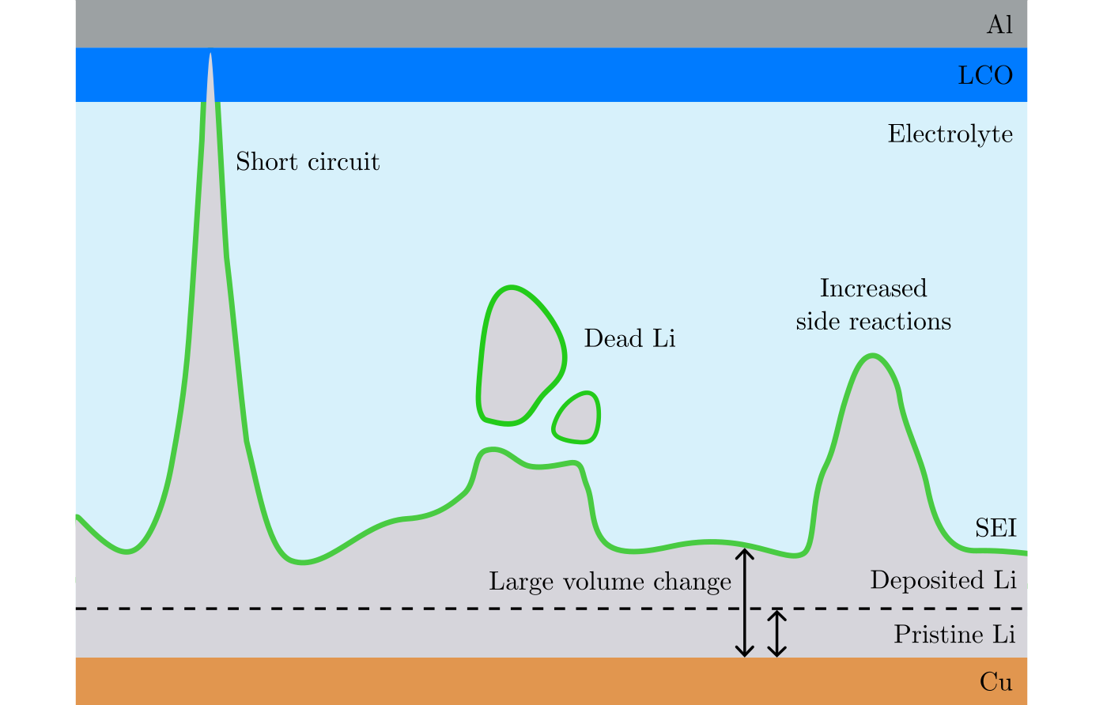
Non-uniform deposition problems

Slide 7
Purpose of this thesis
Investigate pressure, current, passivation

Slide 8
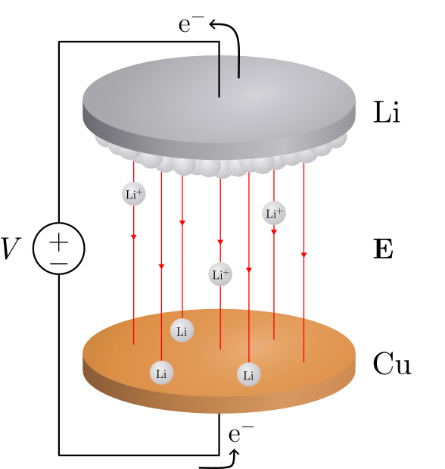
Deposition in a Li/Cu cell

Slide 9
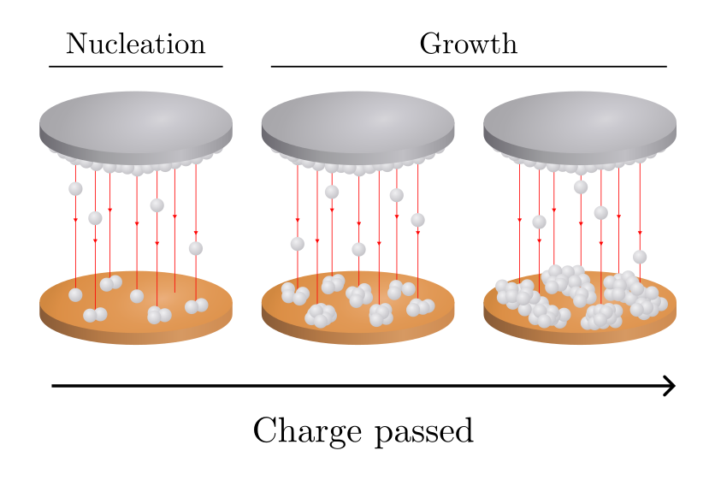
Deposition in a Li/Cu cell

Slide 10
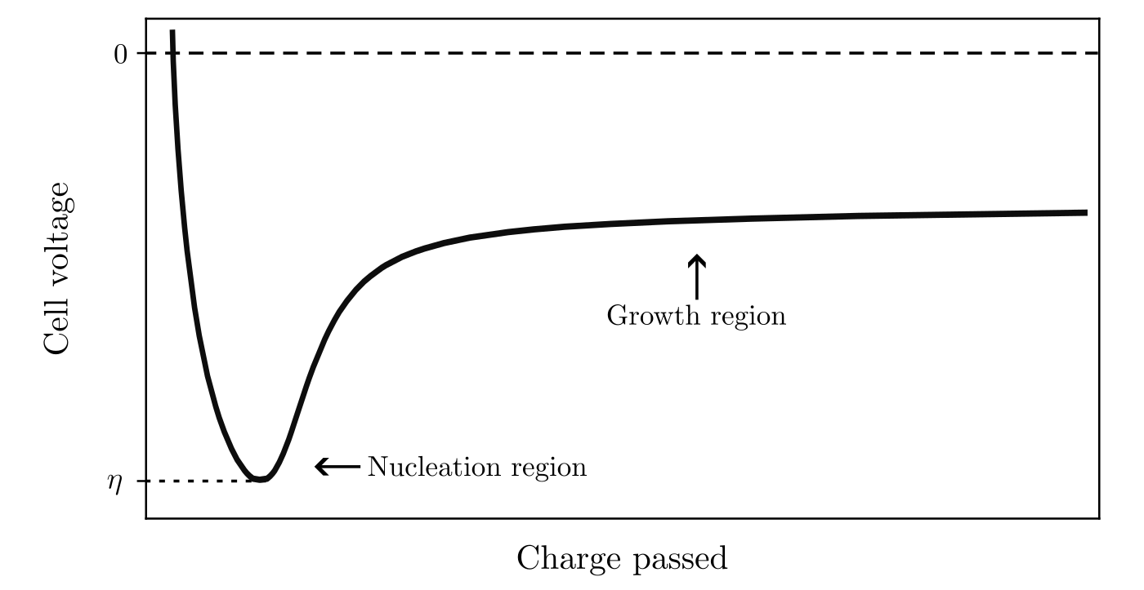
Deposition in a Li/Cu cell

Slide 11
Nucleation theory
//describe: nucleation here: form solid Li from a solution of Li+ (figure!)
Use thermodynamics to theoretically model this (next slide)

Slide 12
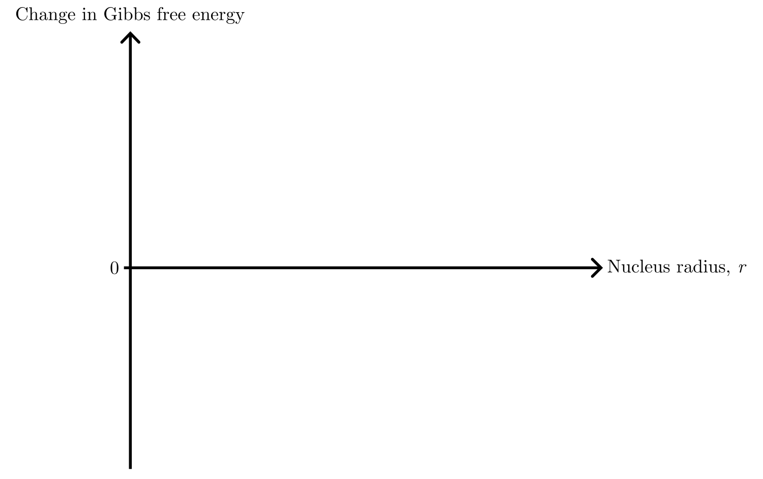
Nucleation theory

Slide 13
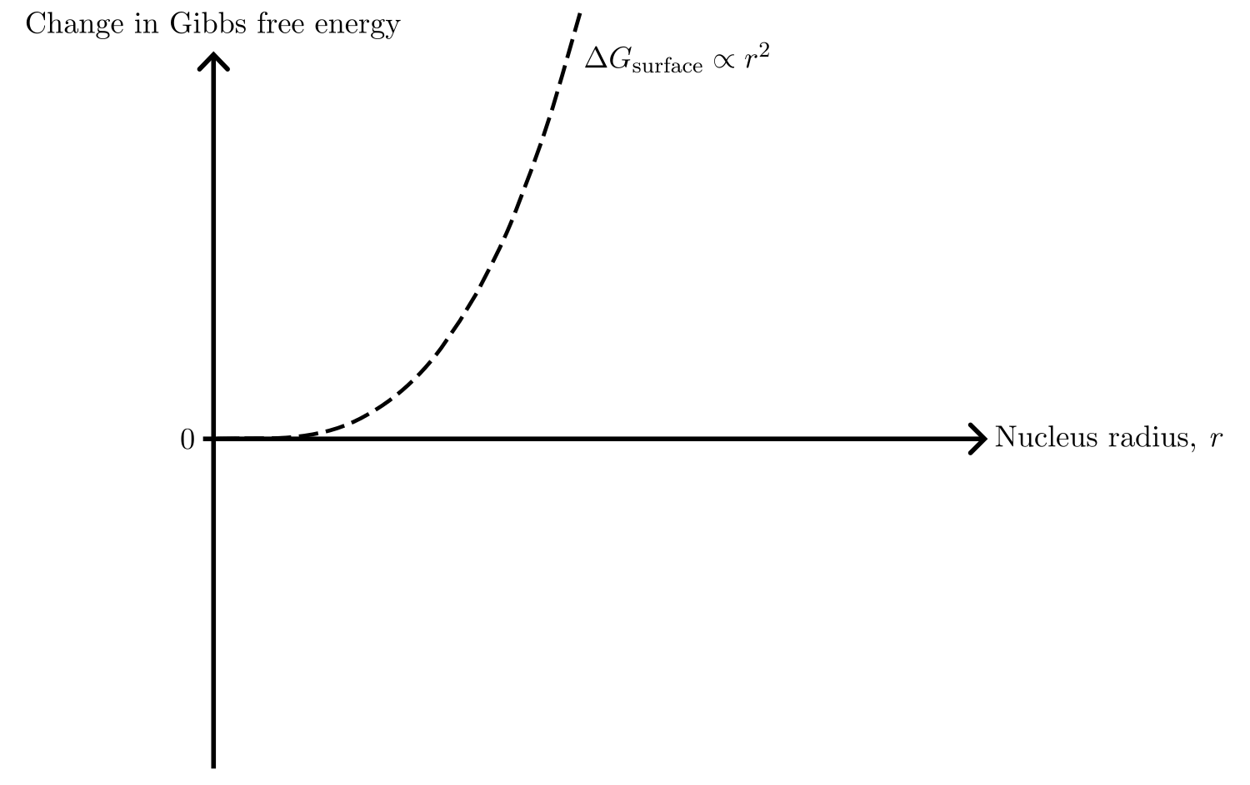
Nucleation theory

Slide 14
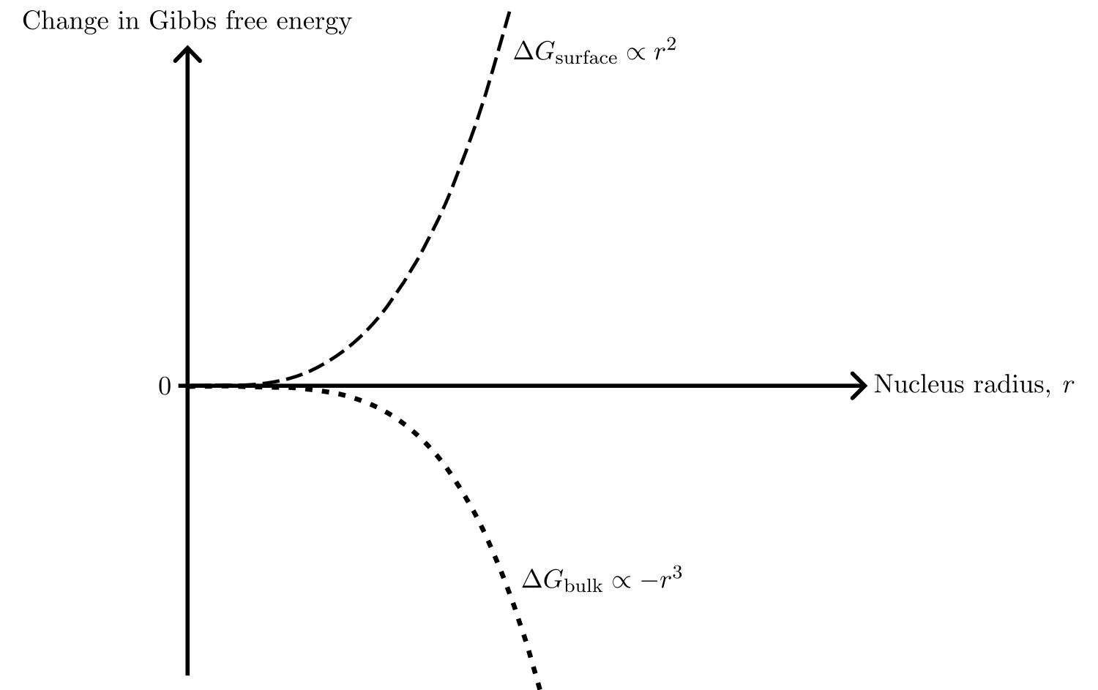
Nucleation theory

Slide 15
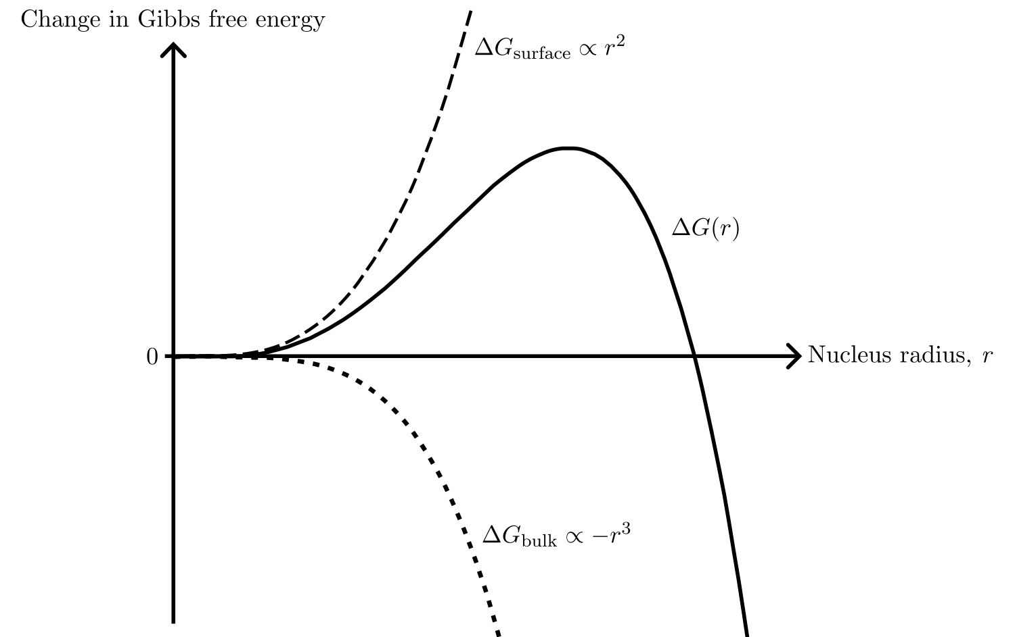
Nucleation theory

Slide 16
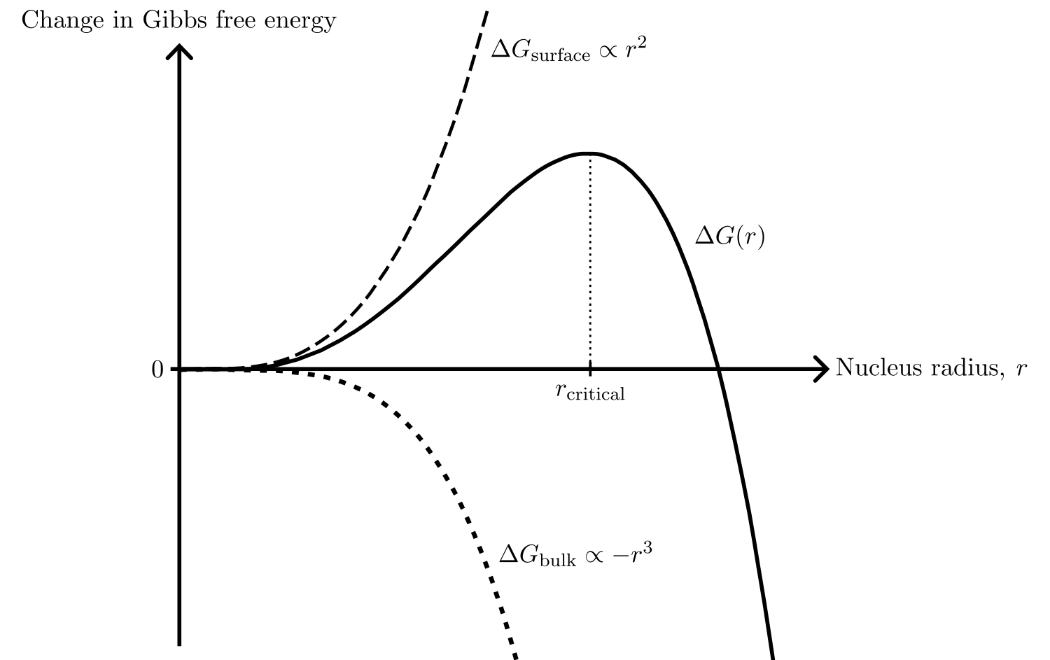
Nucleation theory

Slide 17
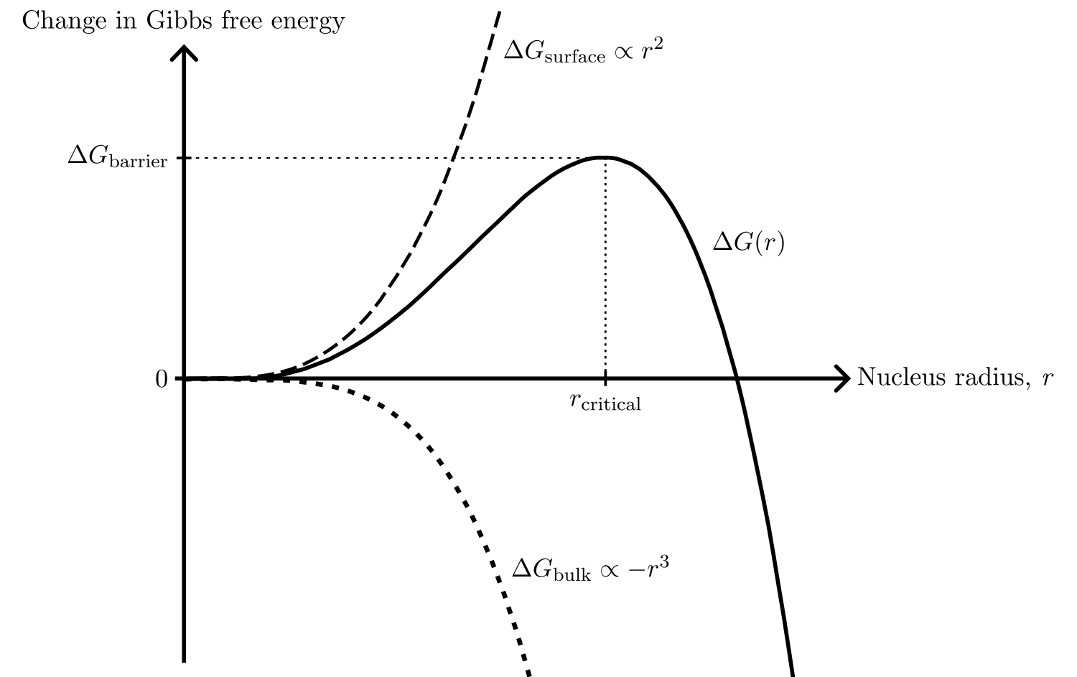
Nucleation theory

Slide 18
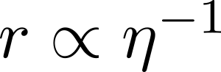
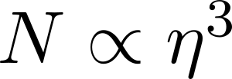
Nucleation theory

Slide 19
Nucleation theory

Slide 20
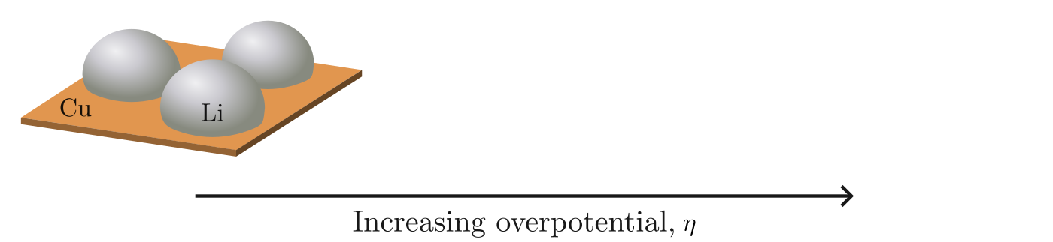
Nucleation theory

Slide 21
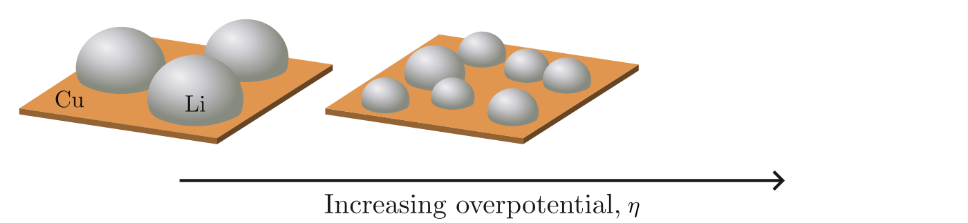
Nucleation theory

Slide 22
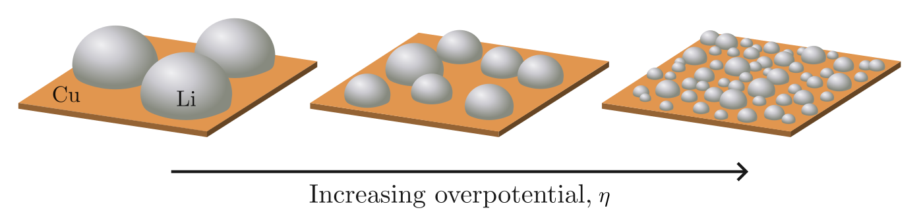
Nucleation theory

Slide 23
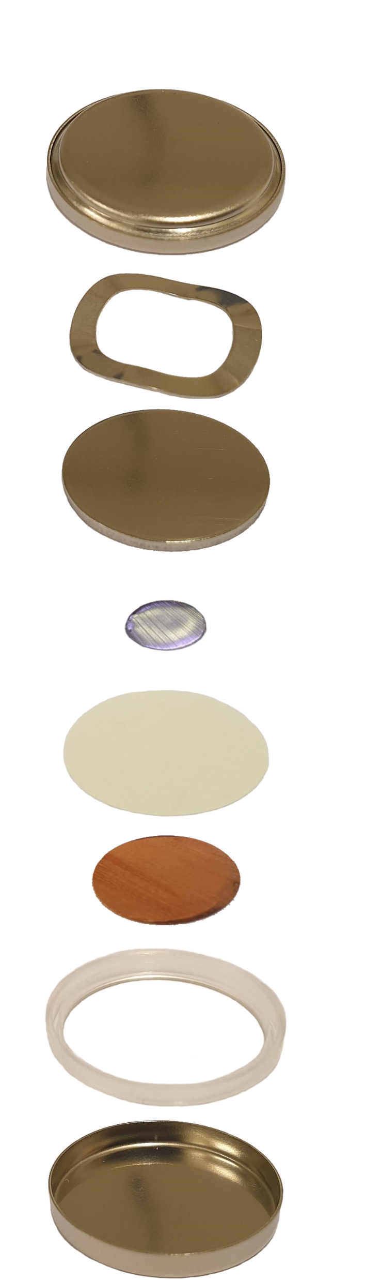
The C-cell
Cap
Spring
Spacer
Li
Separator
Cu
Gasket
Can

Slide 24
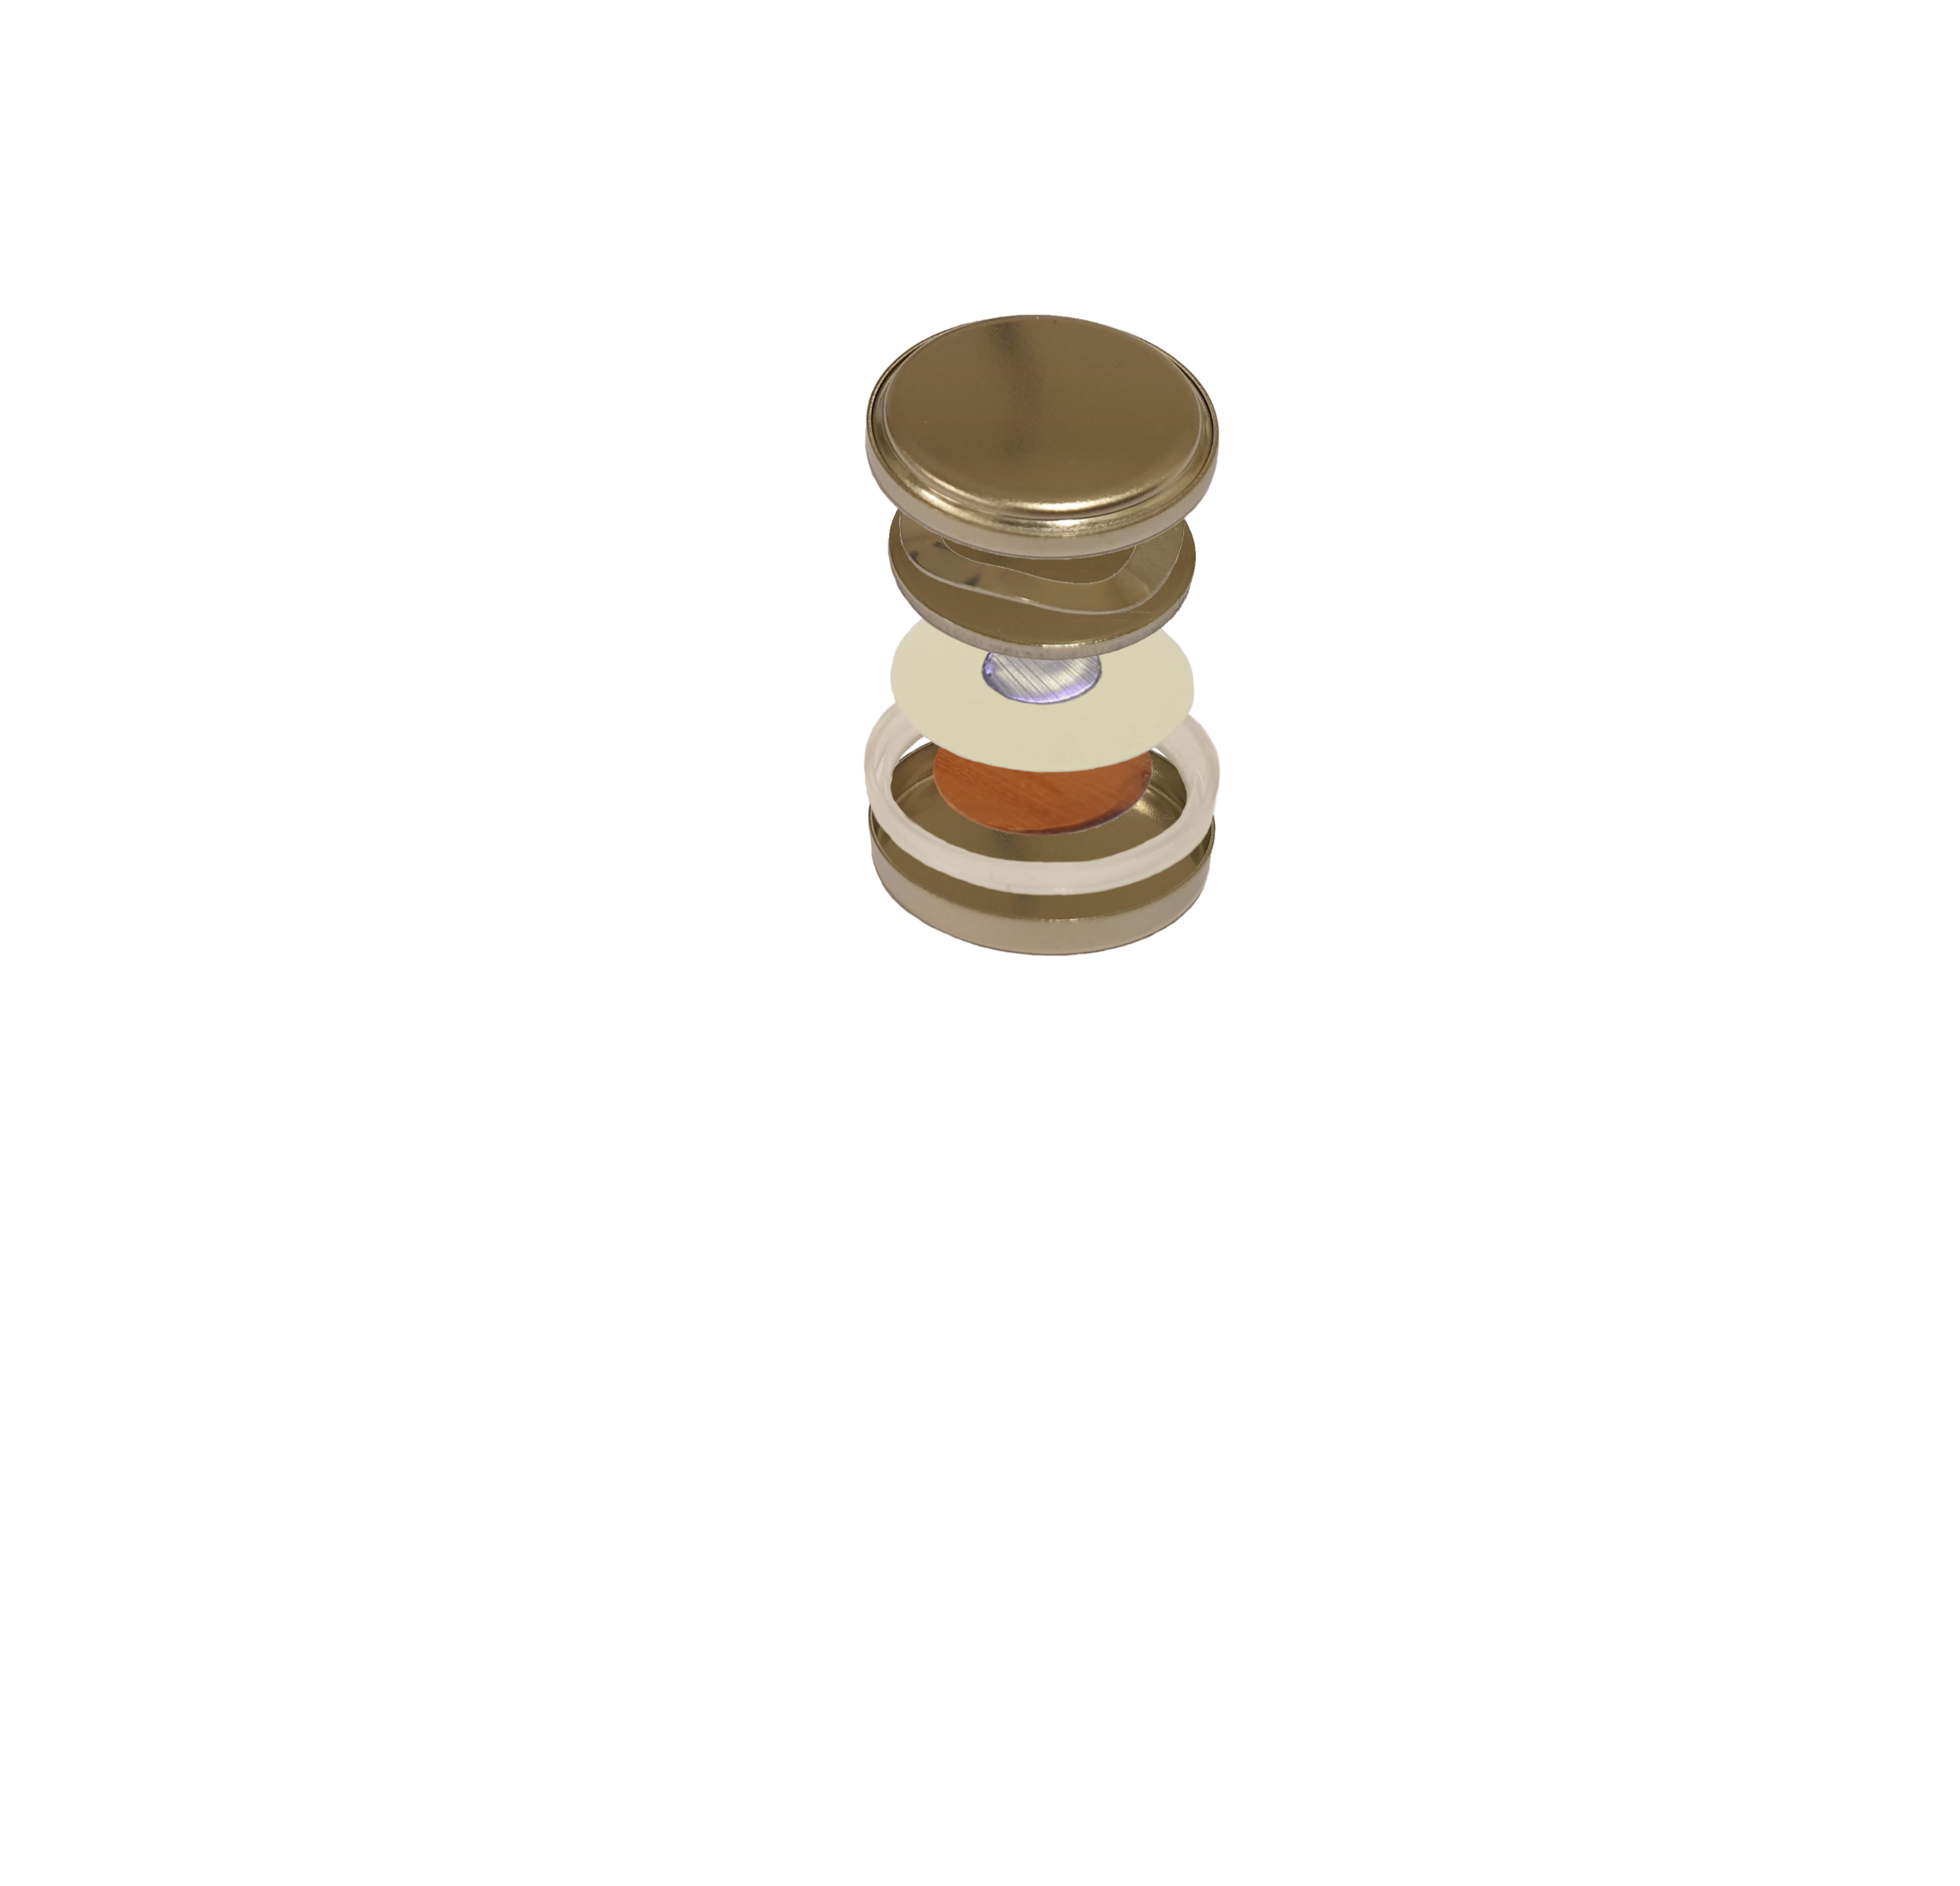
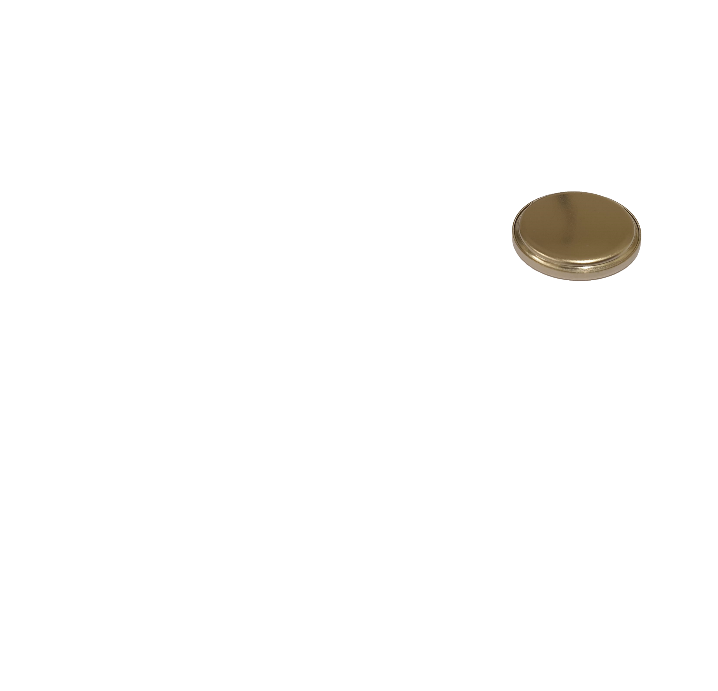
The C-cell
Cap
Spring
Spacer
Li
Separator
Cu
Gasket
Can

Slide 25
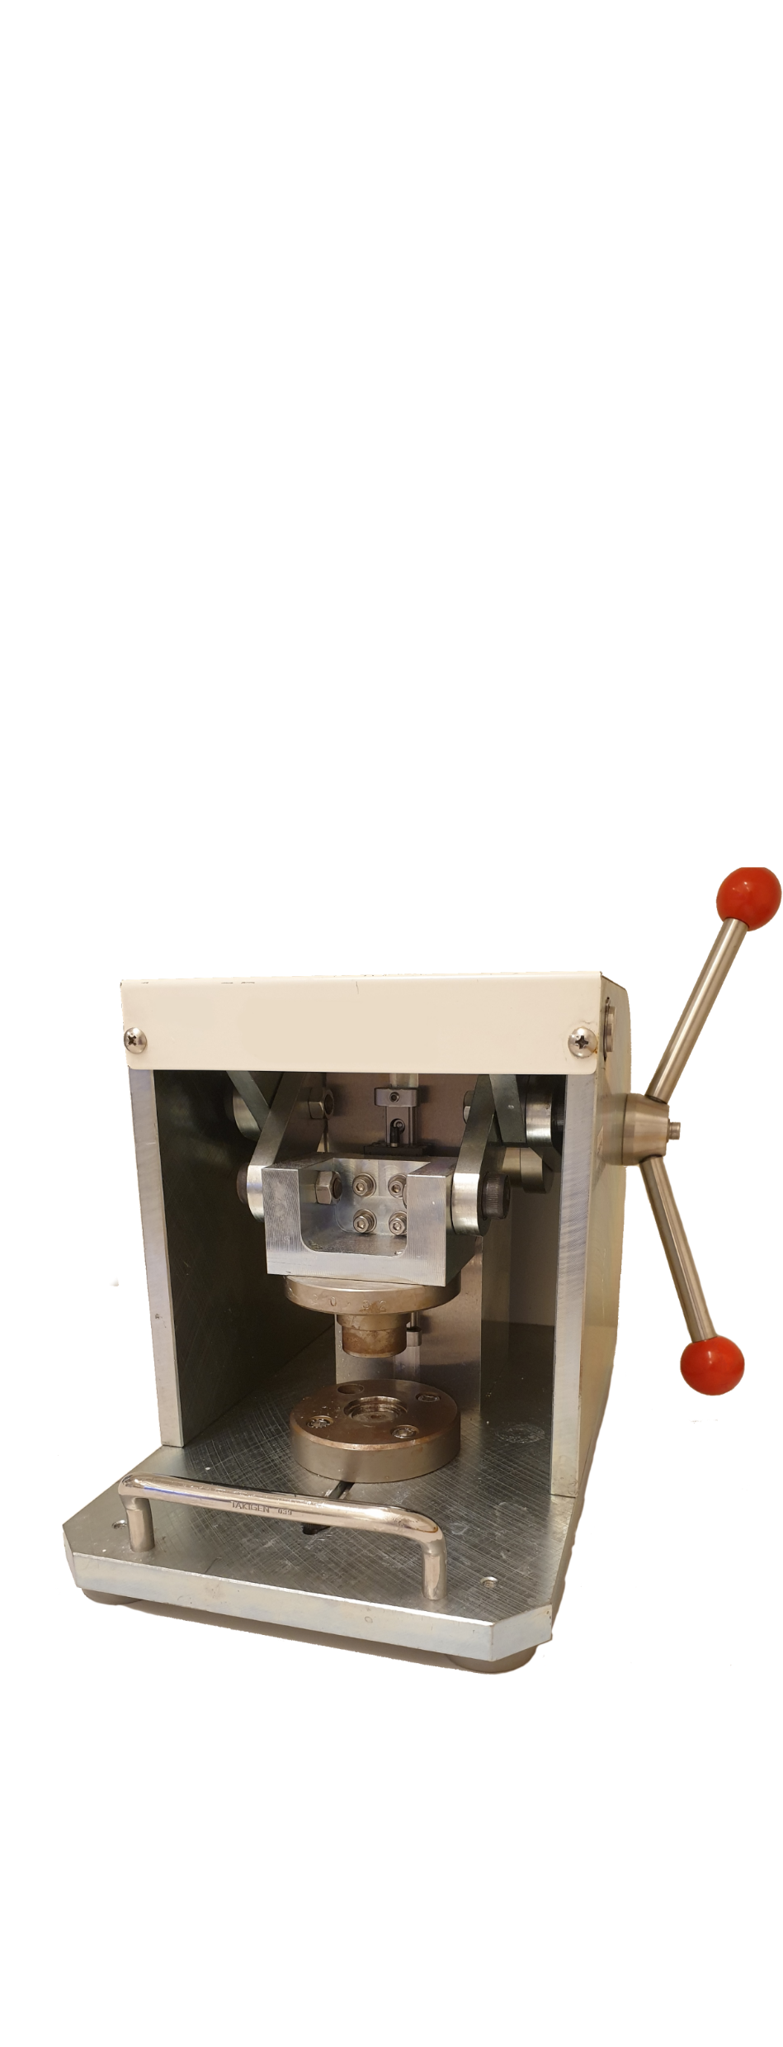
The C-cell
Cap
Spring
Spacer
Li
Separator
Cu
Gasket
Can

Slide 26

The C-cell
Cap
Spring
Spacer
Li
Separator
Cu
Gasket
Can

Slide 27
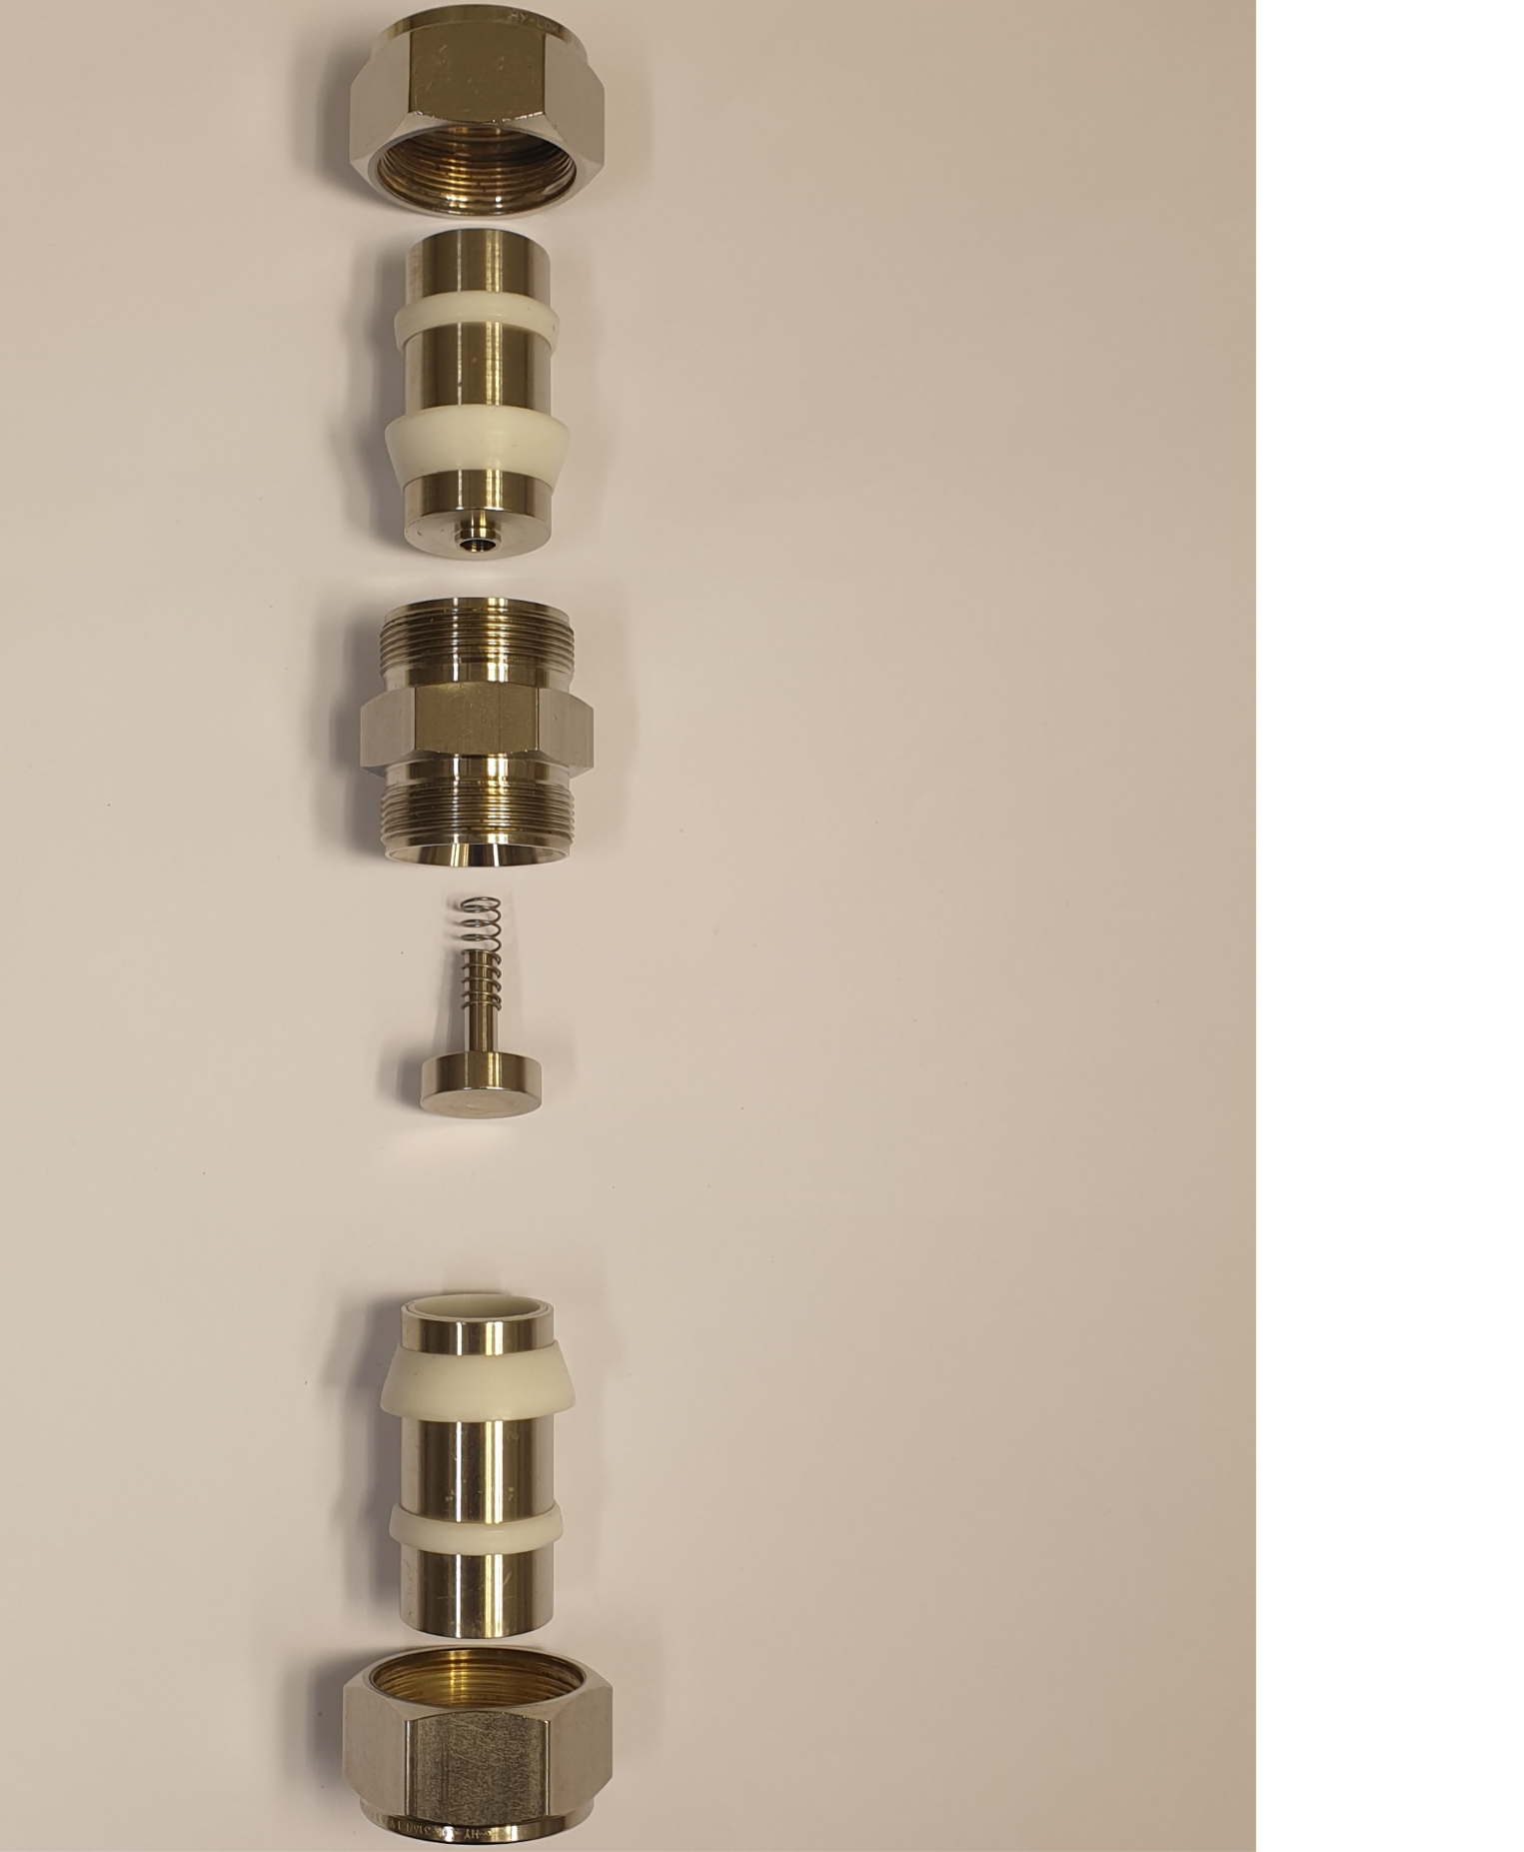
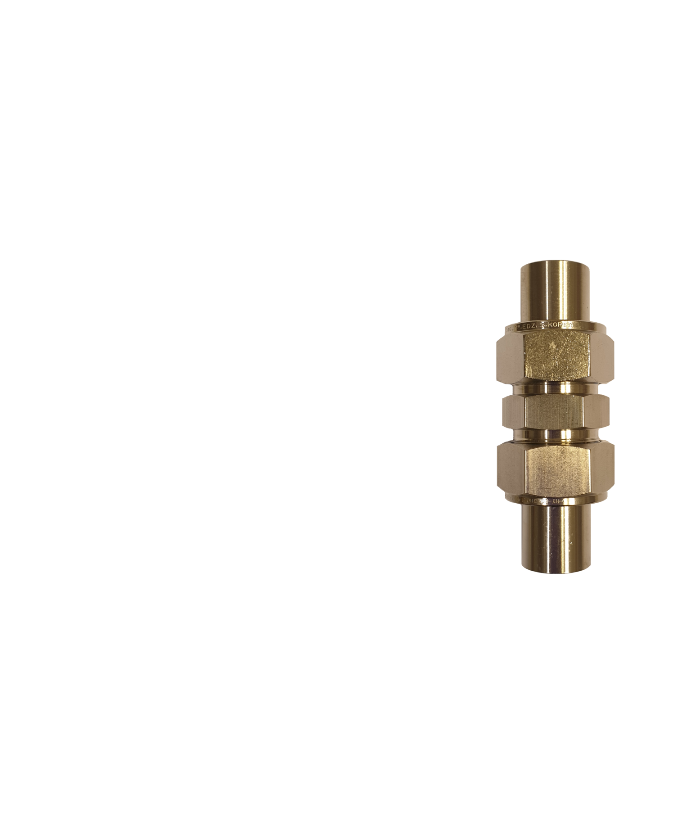

The I-cell
Nut
Metal rod
Sealing
rings
Main body
Spring
Spacer
Li
Separator
Cu

Slide 28
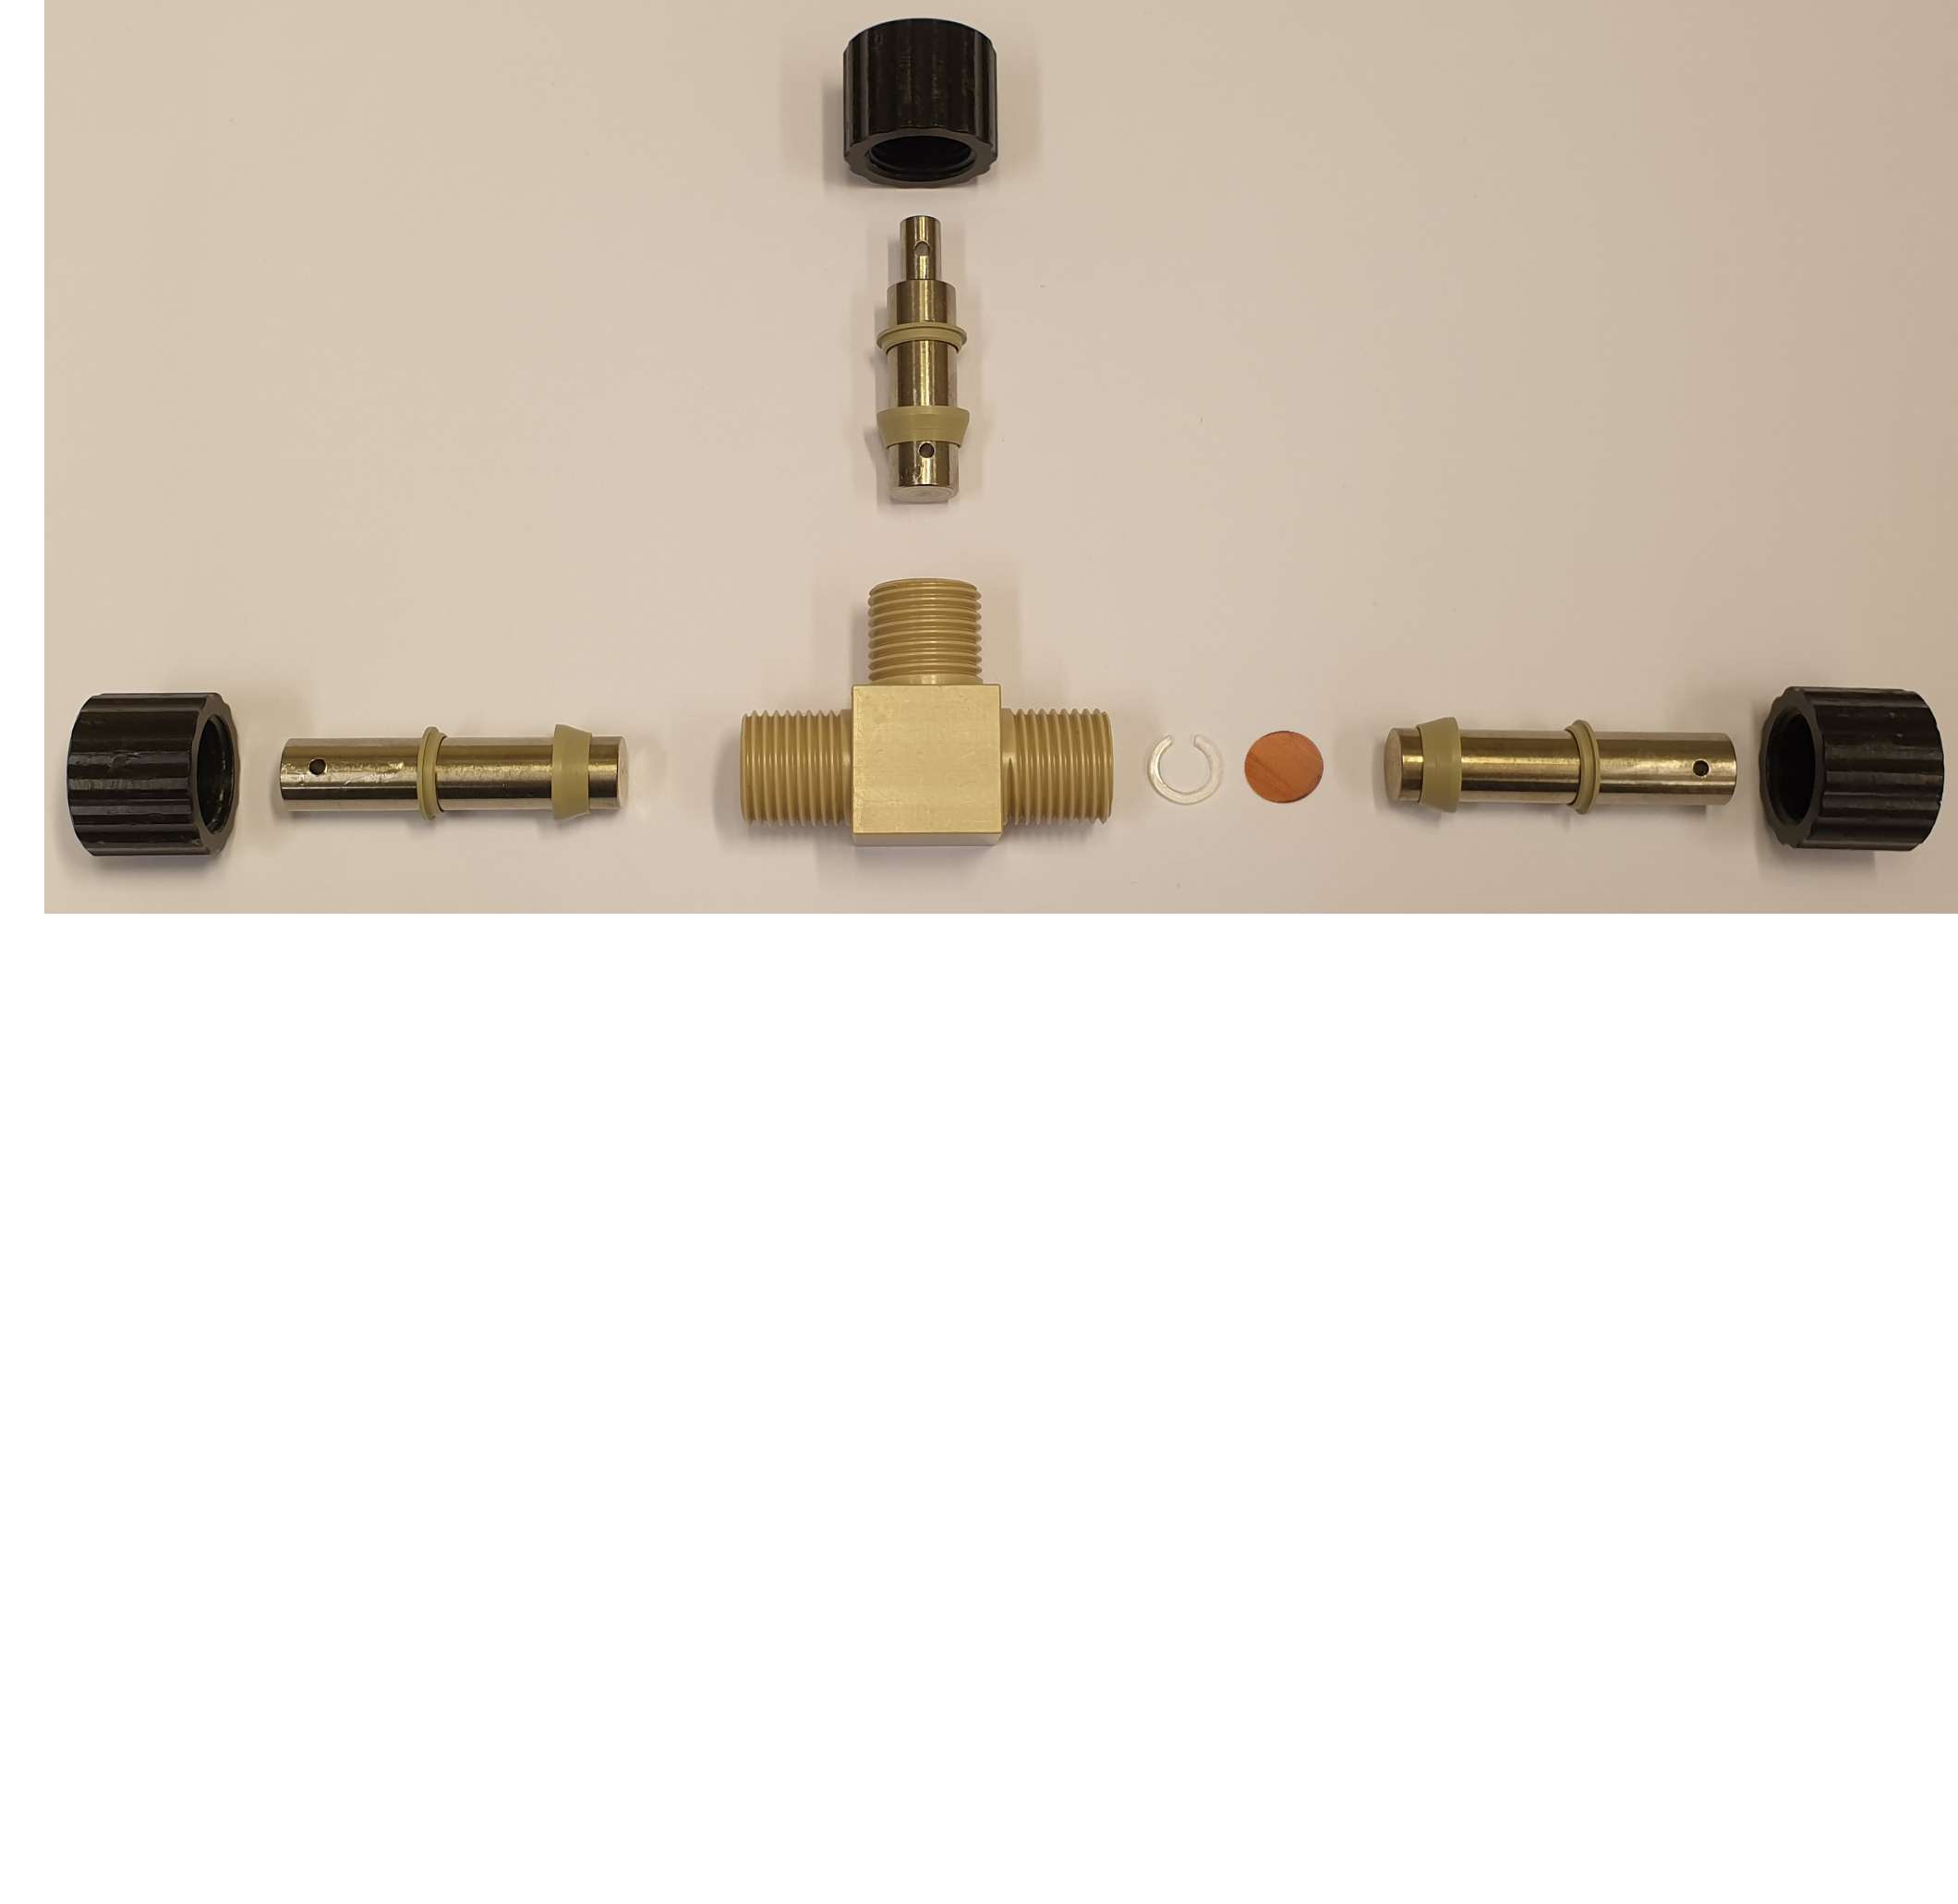

The T-cell
Nut
Metal rod
Sealing rings
Li
Main body
Spacer
Cu

Slide 29
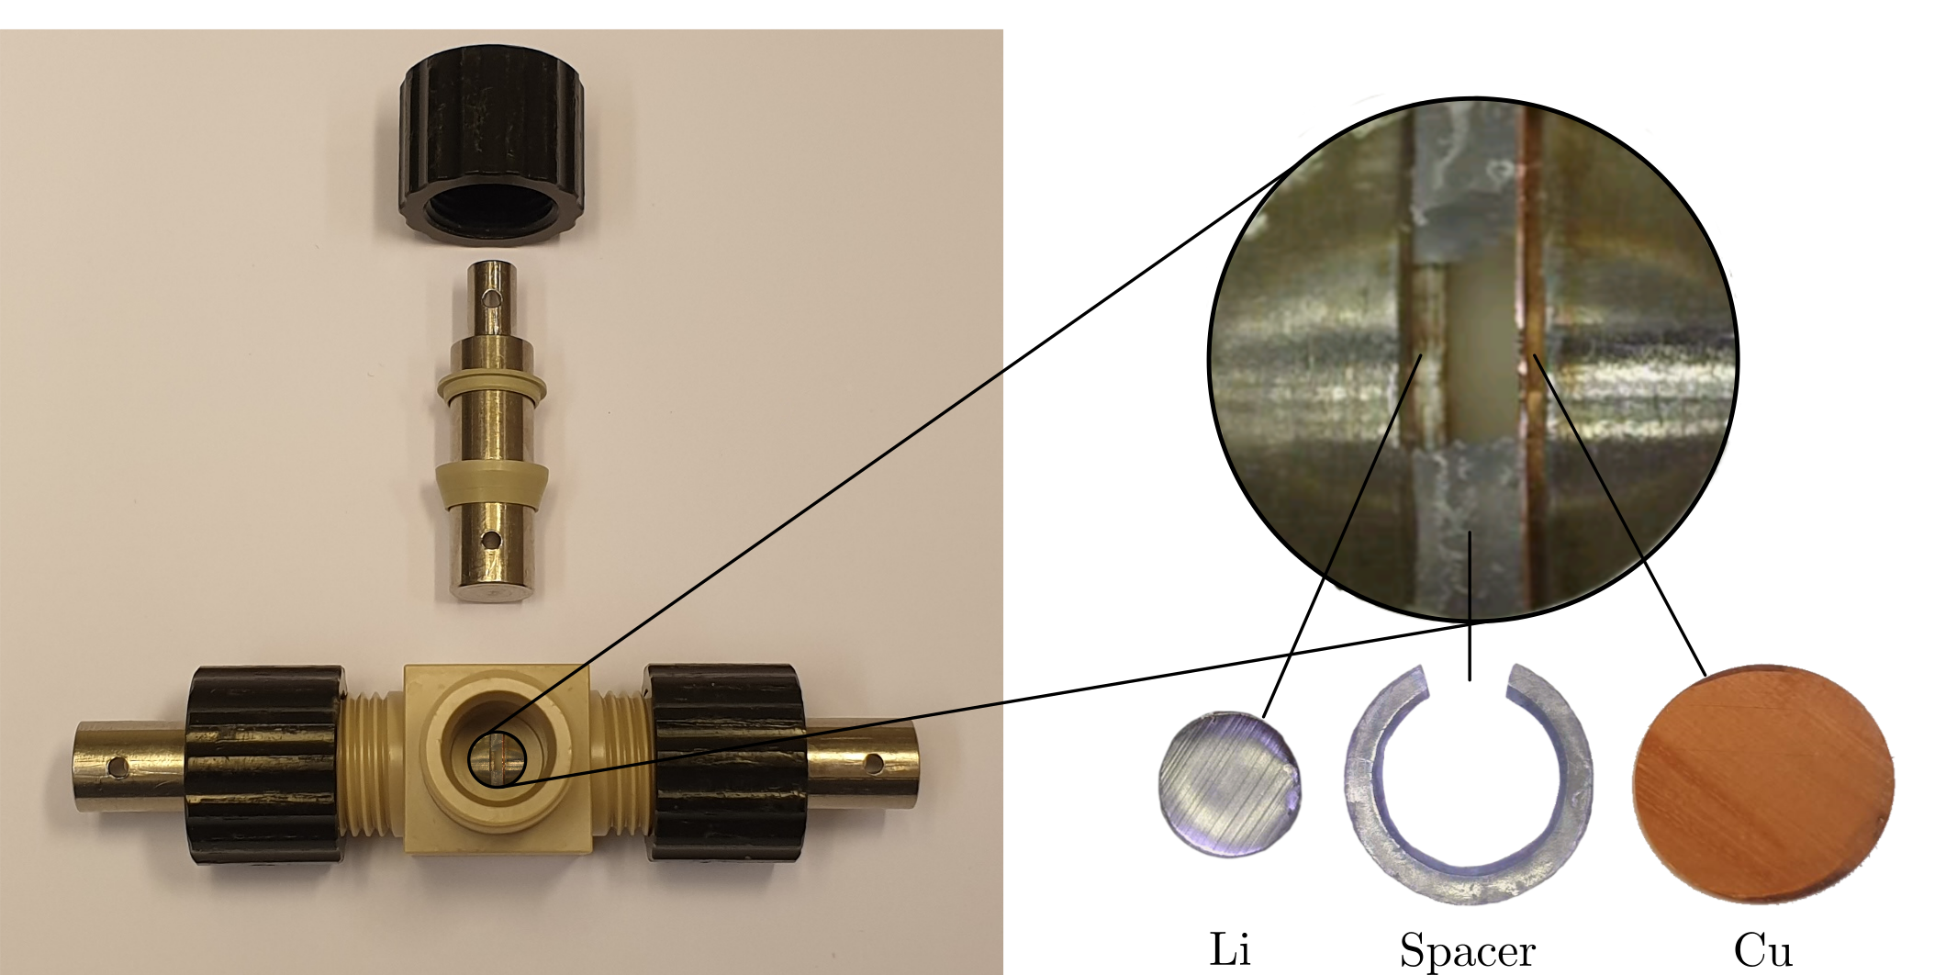
The T-cell

Slide 30
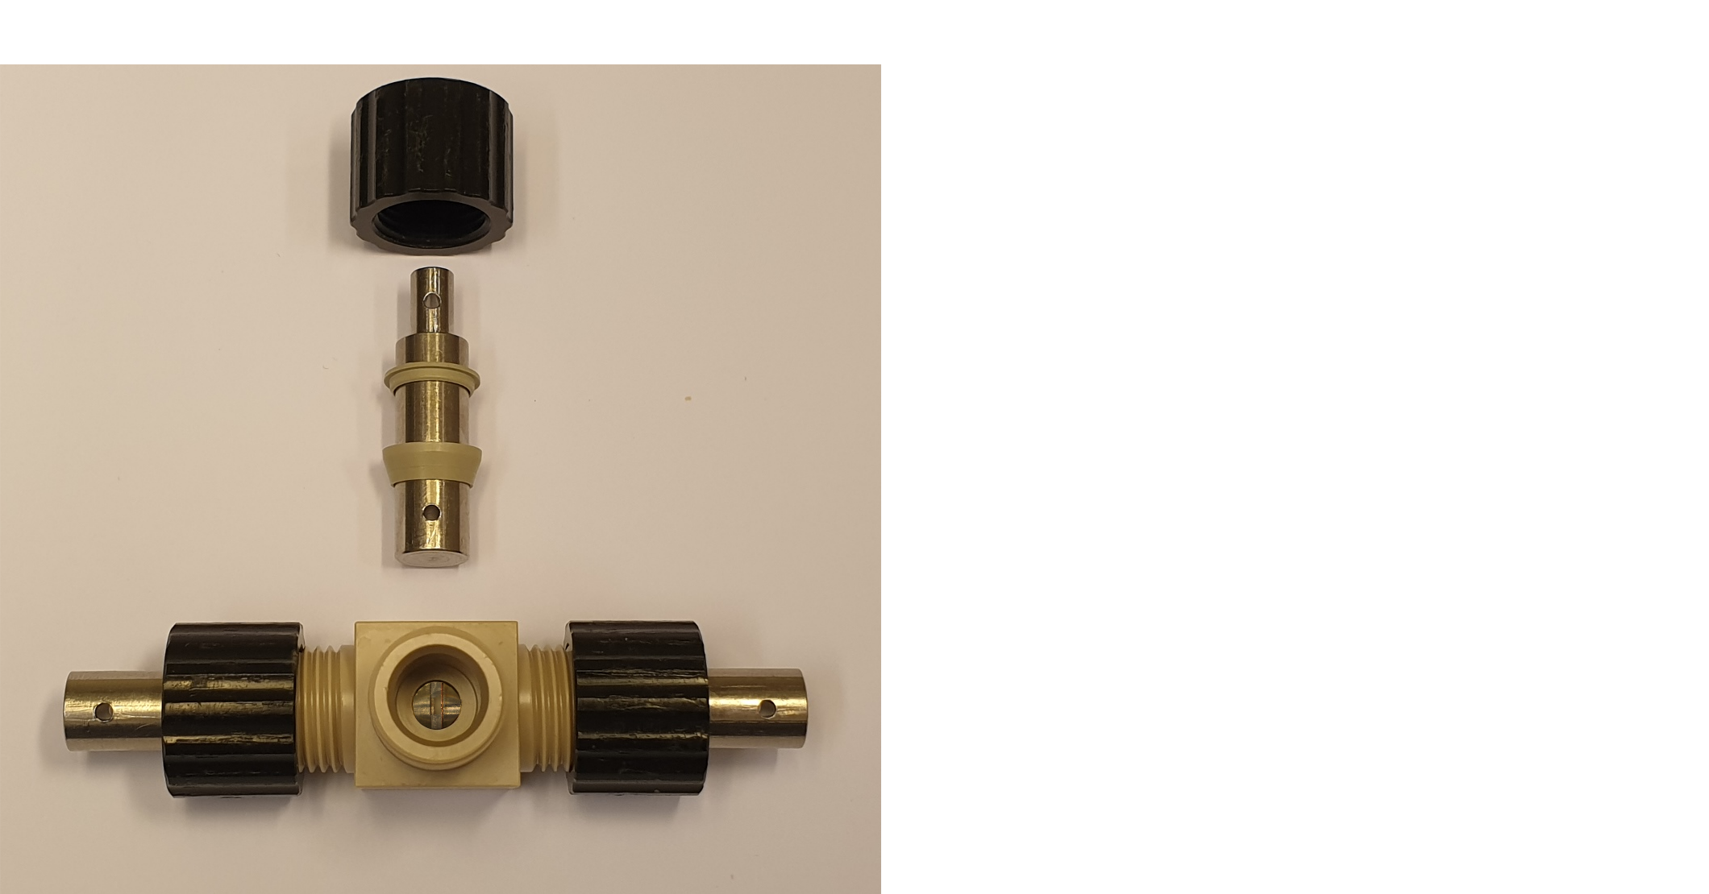
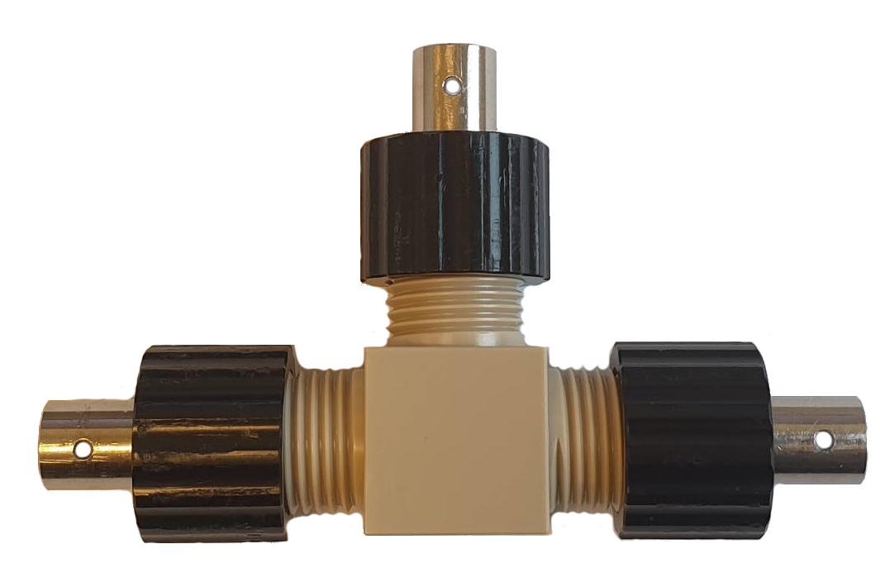
The T-cell

Slide 31
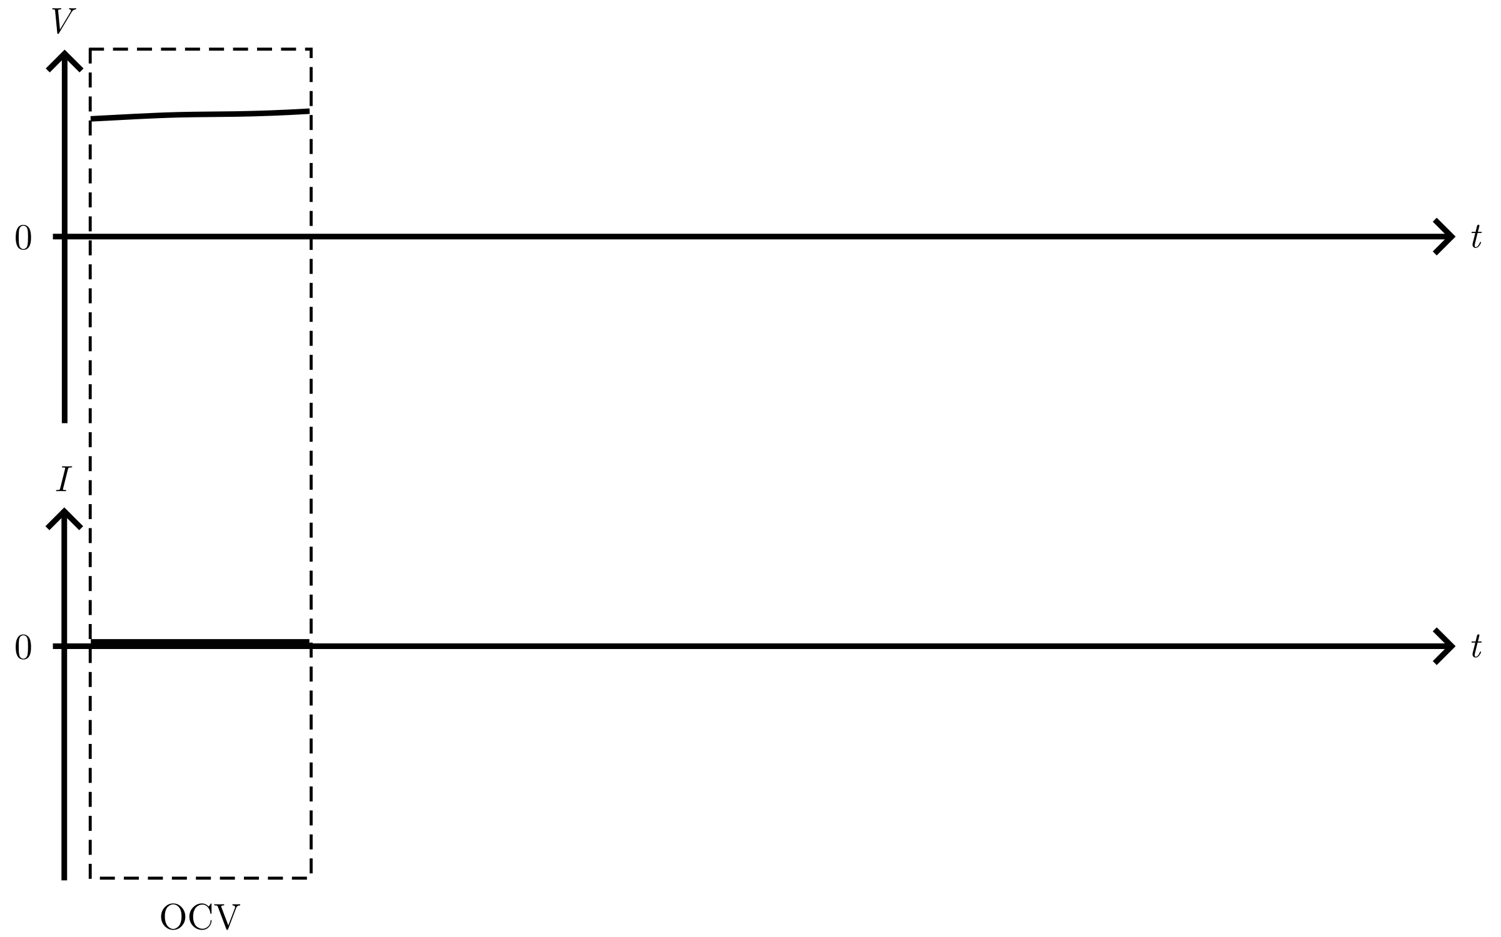
Deposition protocol

Slide 32
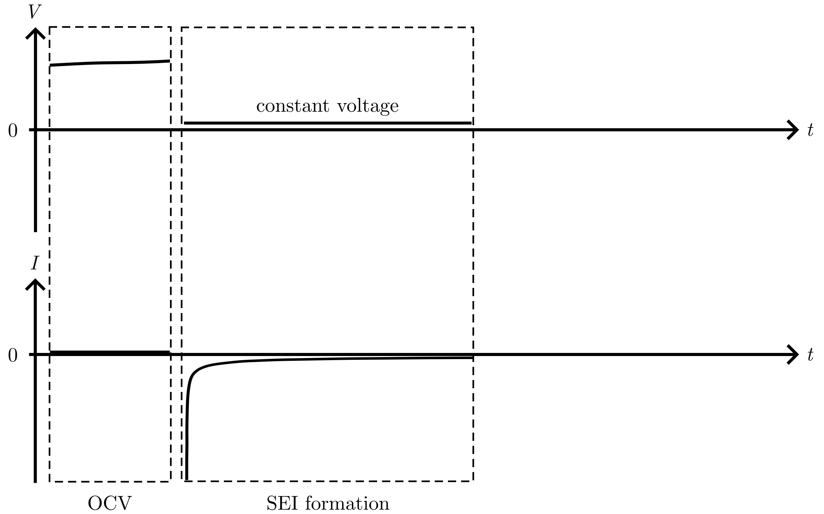
Deposition protocol

Slide 33
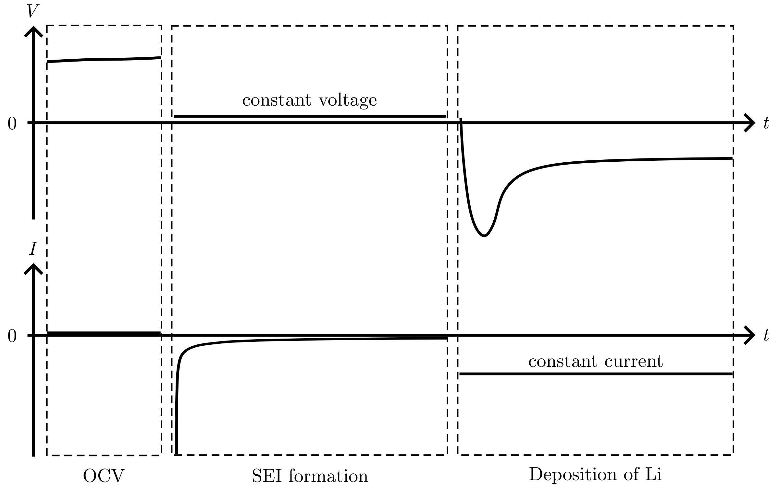
Deposition protocol

Slide 34
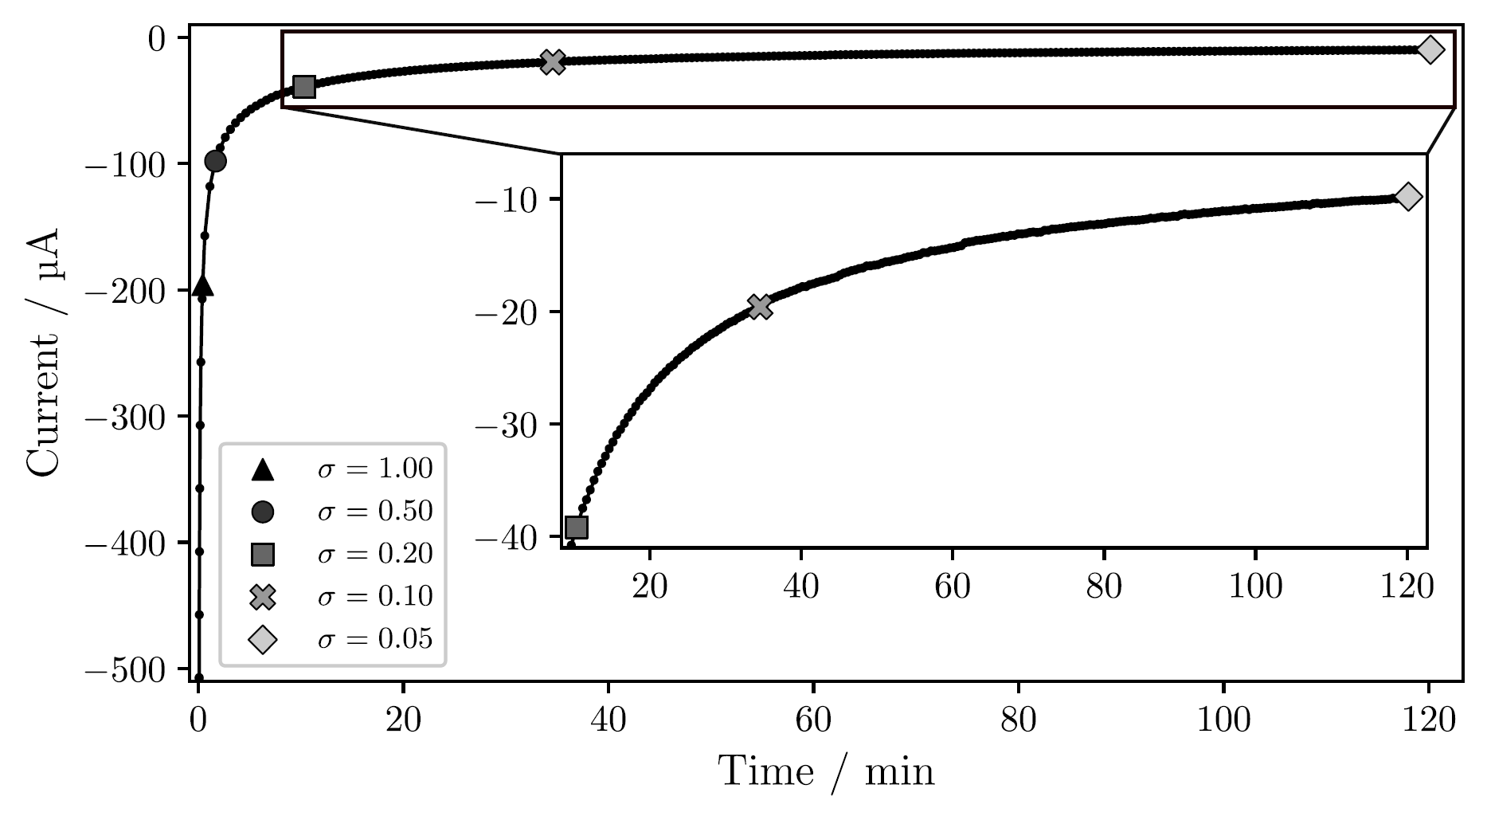
Passivation of the Cu surface
Notes:
T-cell, Jdeposition = 1 mAh/cm²
Time increase for lower sigma: 2 min for 0.50, 2 hour for 0.05, over 25 hours for 0.01

Slide 35
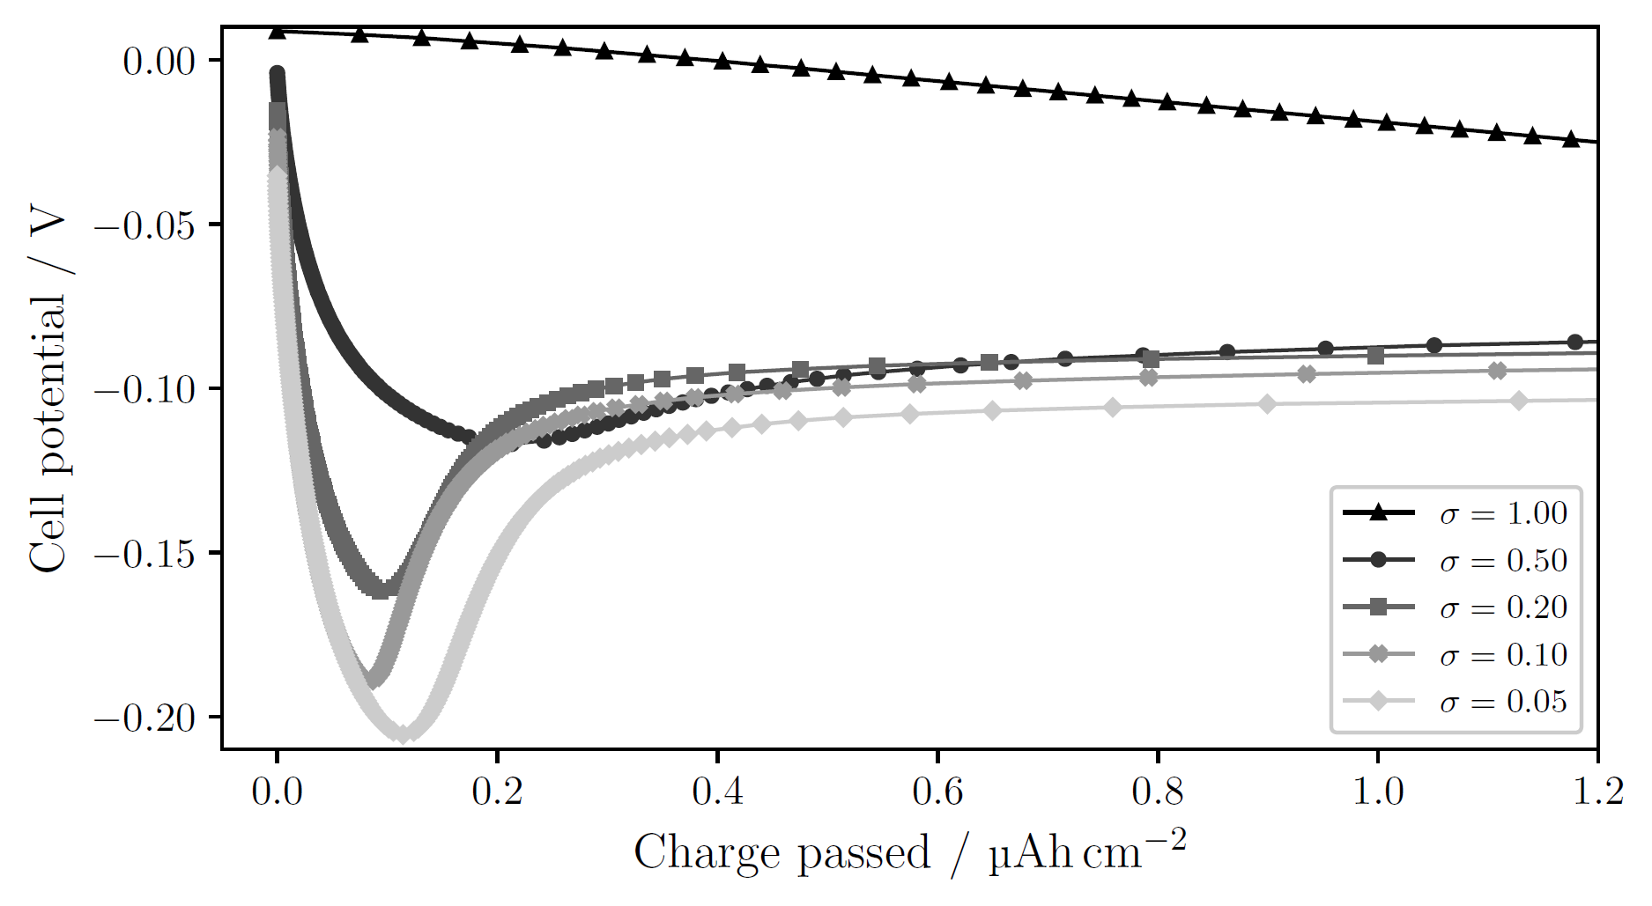
Passivation of the Cu surface
Notes:
T-cell, 1 mAh/cm²
sigma=1.00: no obvious nucleation; side reactions large enough to drive current without need for nucleation
Decreasing sigma → clearer deposition peak at higher overpotential
Larger overpotential → smaller nuclei, larger N → many sites for continued growth, lowering the necessity for further nucleation. Other words: more instantaneous nucleation (all nuclei form at the start and then they only grow).
Opposed to progressive nucleation, where nuclei continue to form as other grow

Slide 36
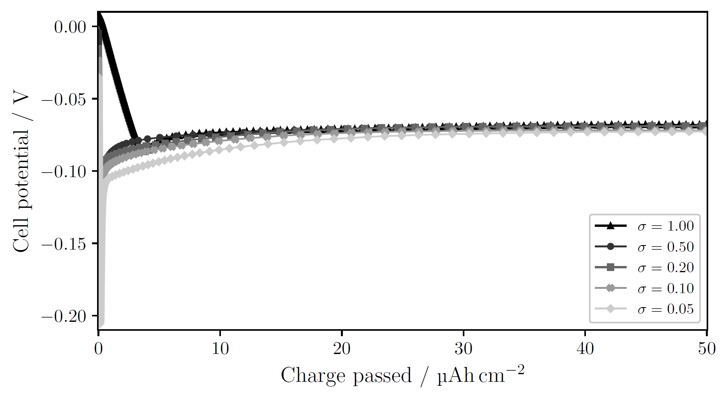
Passivation of the Cu surface larger charge passed
Notes:
T-cell, 1 mAh/cm²
sigma=1.00: no obvious nucleation; side reactions large enough to drive current without need for nucleation
Decreasing sigma → clearer deposition peak at higher overpotential
Larger overpotential → smaller nuclei, larger N → many sites for continued growth, lowering the necessity for further nucleation. Other words: more instantaneous nucleation (all nuclei form at the start and then they only grow).
Opposed to progressive nucleation, where nuclei continue to form as other grow

Slide 37
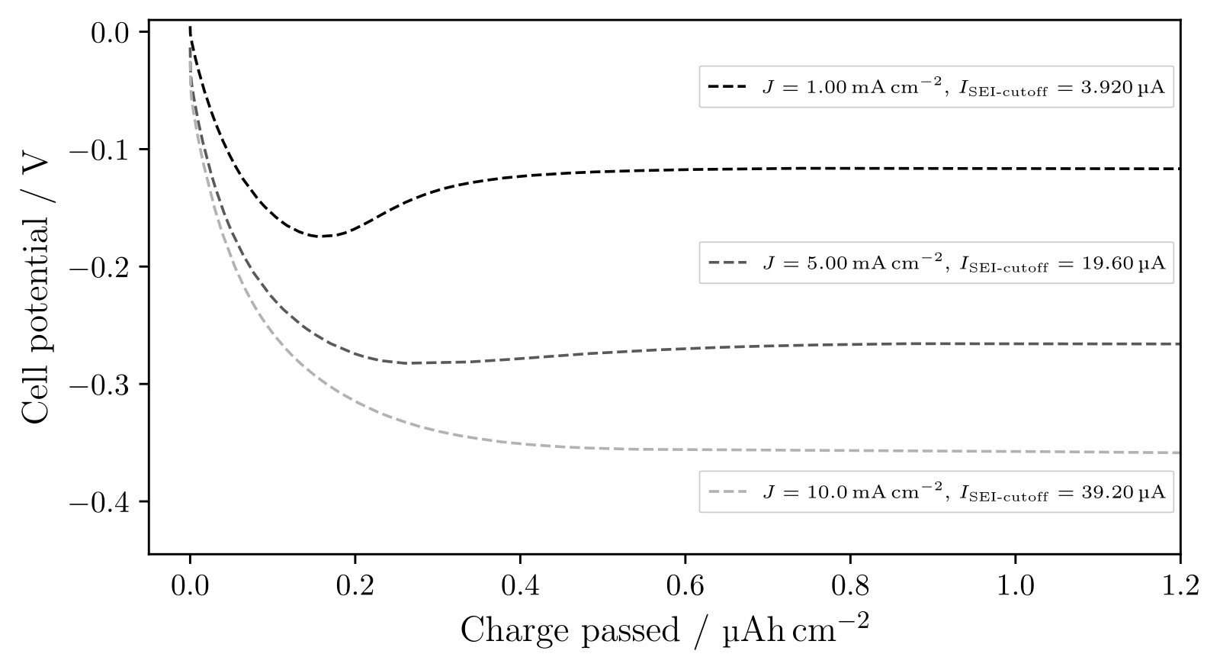
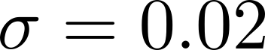
Deposition current

Slide 38
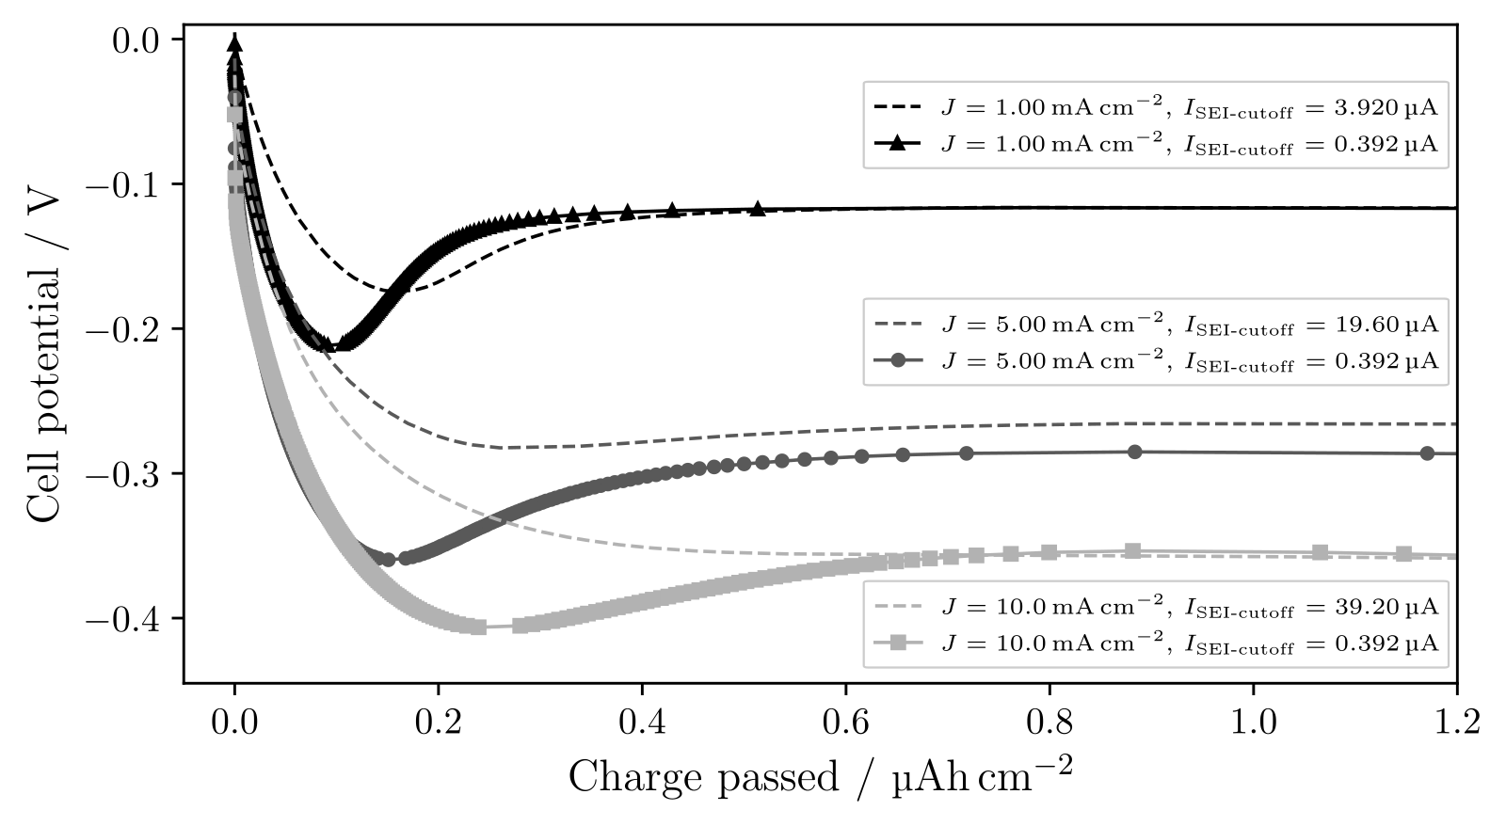
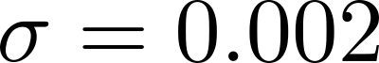
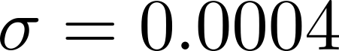
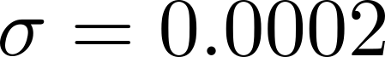
Deposition current with more passivation

Slide 39
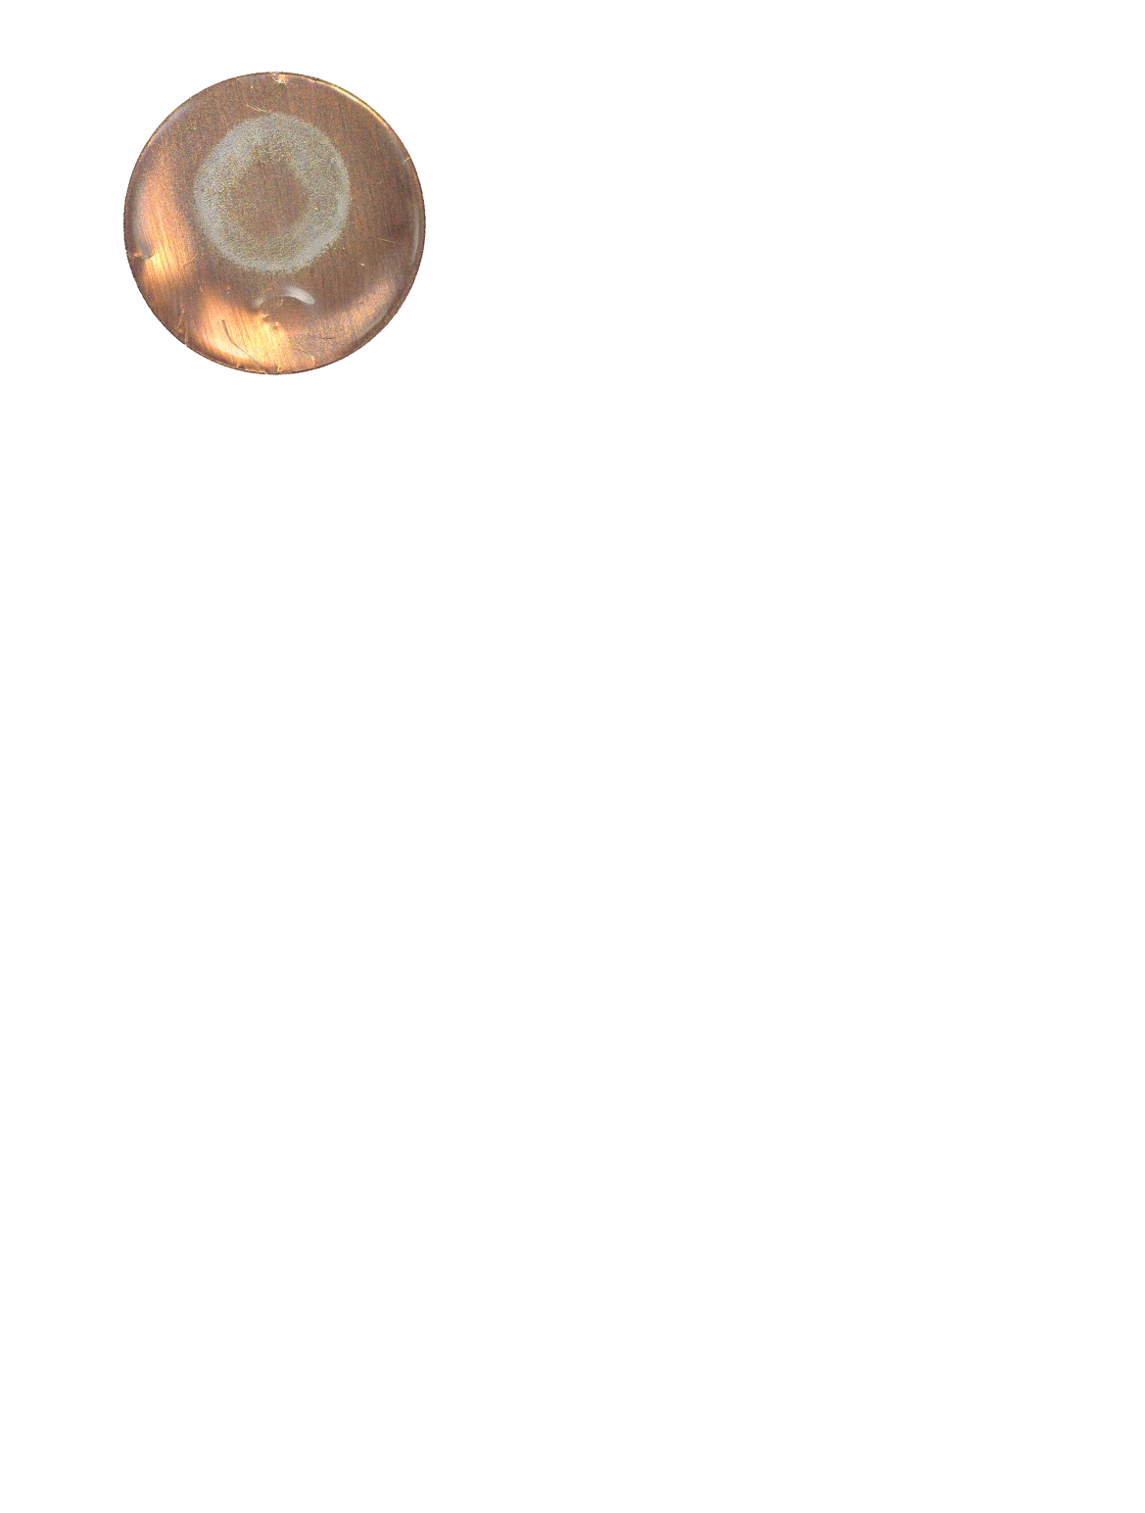
Pressure effects

Slide 40
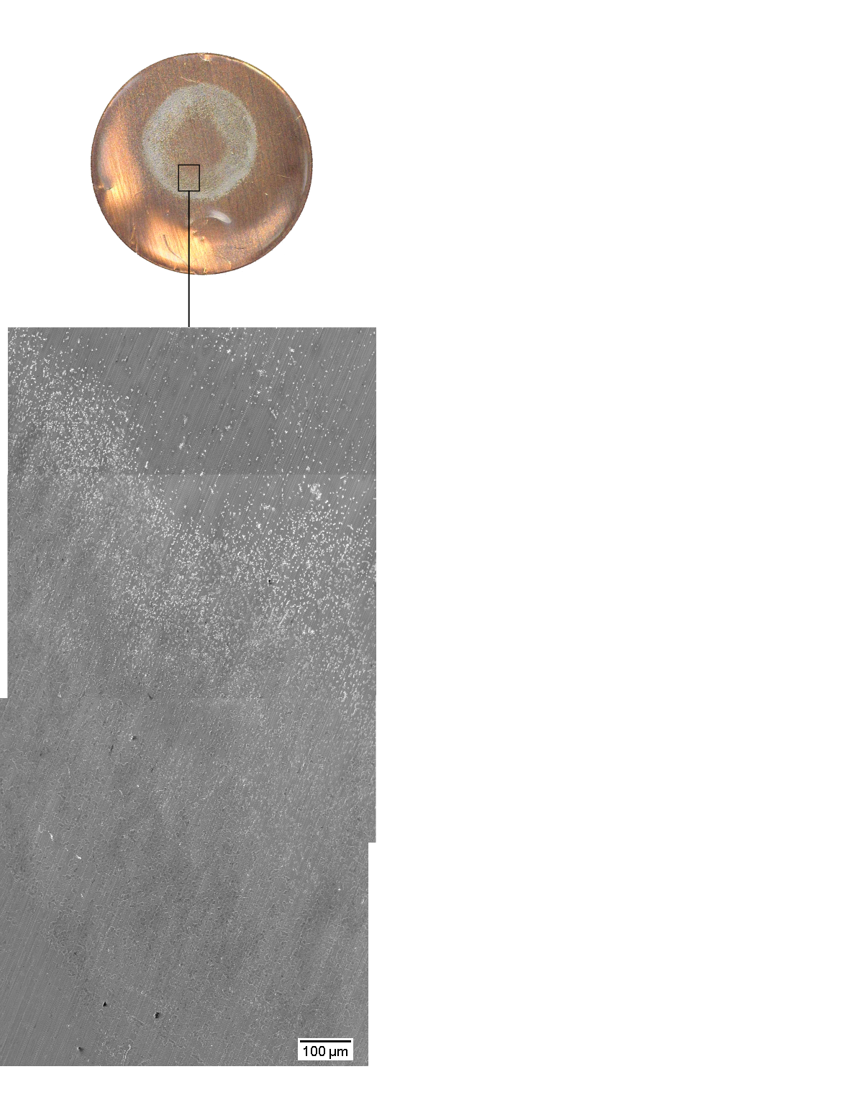
Pressure effects

Slide 41
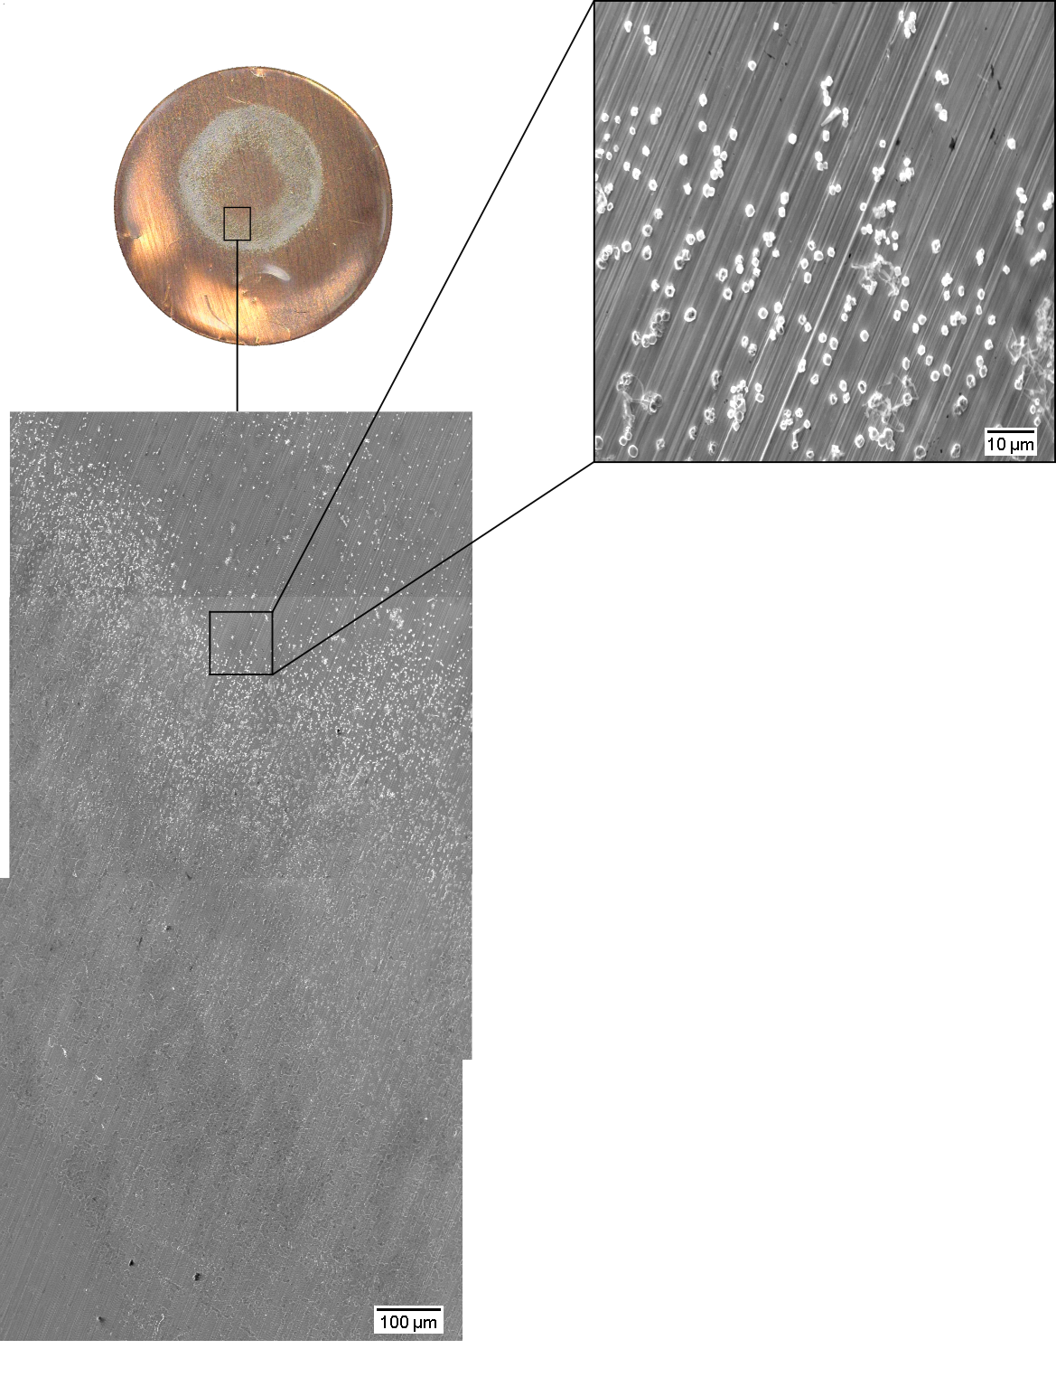
Pressure effects

Slide 42
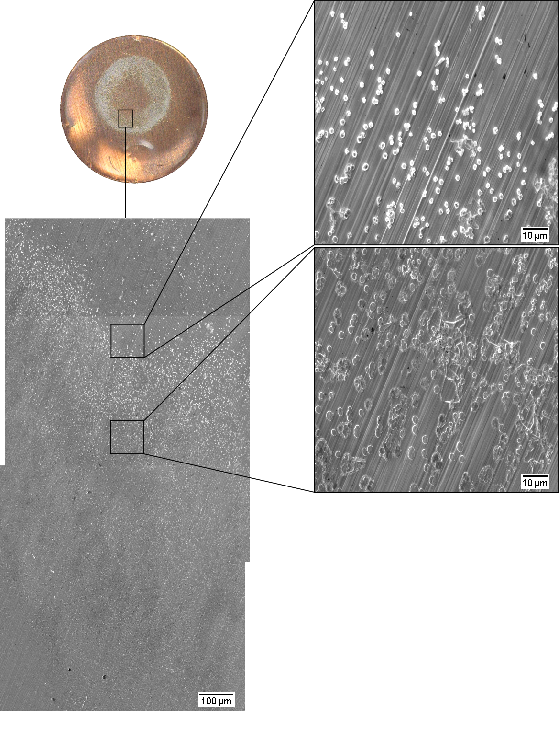
Pressure effects

Slide 43
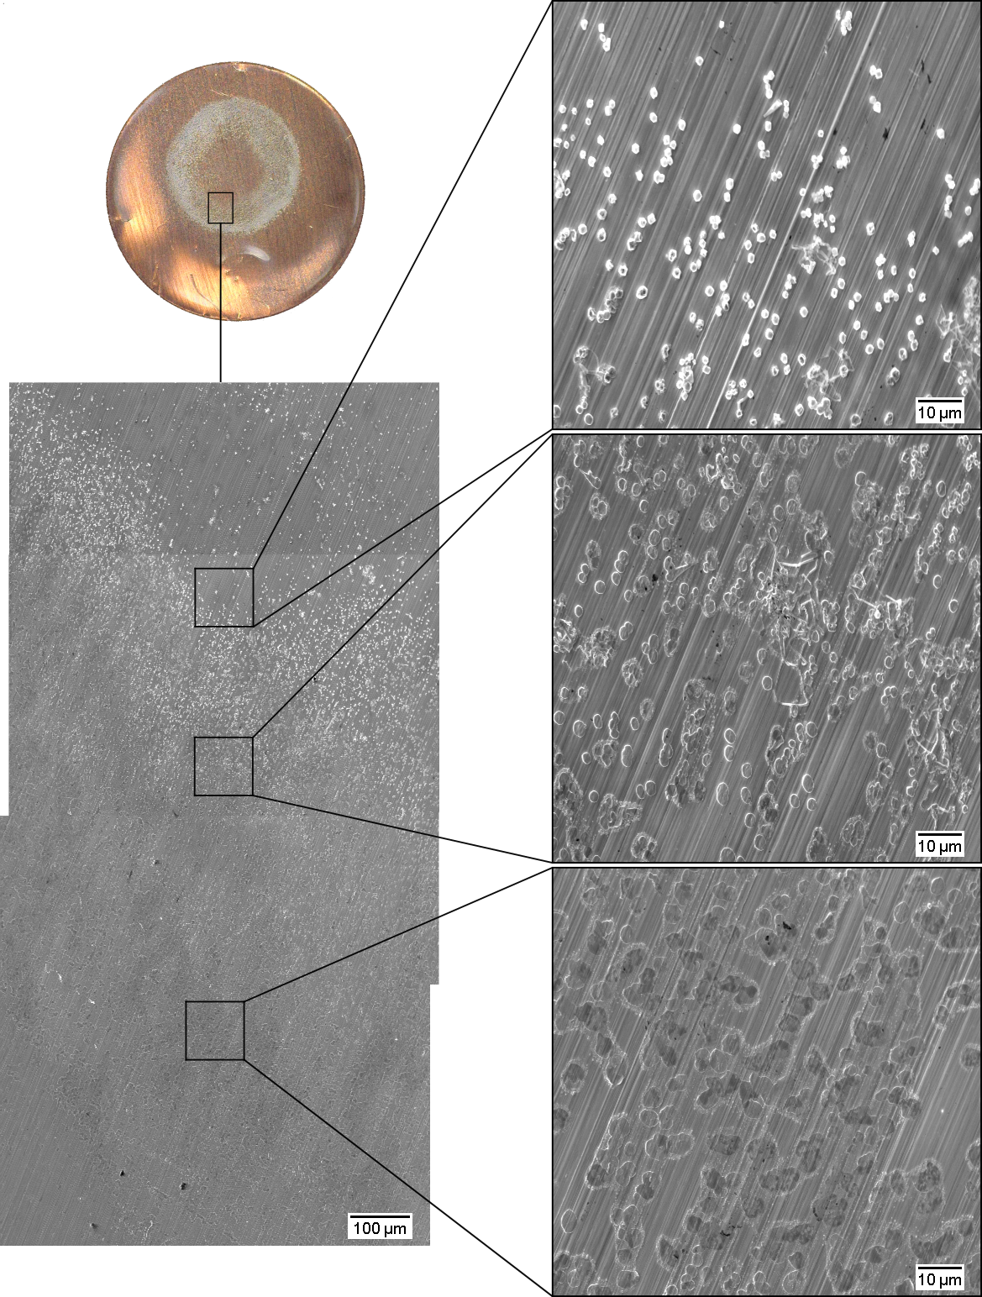
Pressure effects

Slide 44
Pressure effects
2r = 1 µm
2r = 2 µm to 3 µm
2r ≥ 4 µm

Slide 45
Pressure effects
2r = 1 µm
N = 0.024 nuclei/µm²
2r = 2 µm to 3 µm
N = 0.022 nuclei/µm²
2r ≥ 4 µm
N = 0.016 nuclei/µm²

Slide 46
Pressure effects
2r = 1 µm
N = 0.024 nuclei/µm²
2r = 2 µm to 3 µm
N = 0.022 nuclei/µm²
2r ≥ 4 µm
N = 0.016 nuclei/µm²

Slide 47
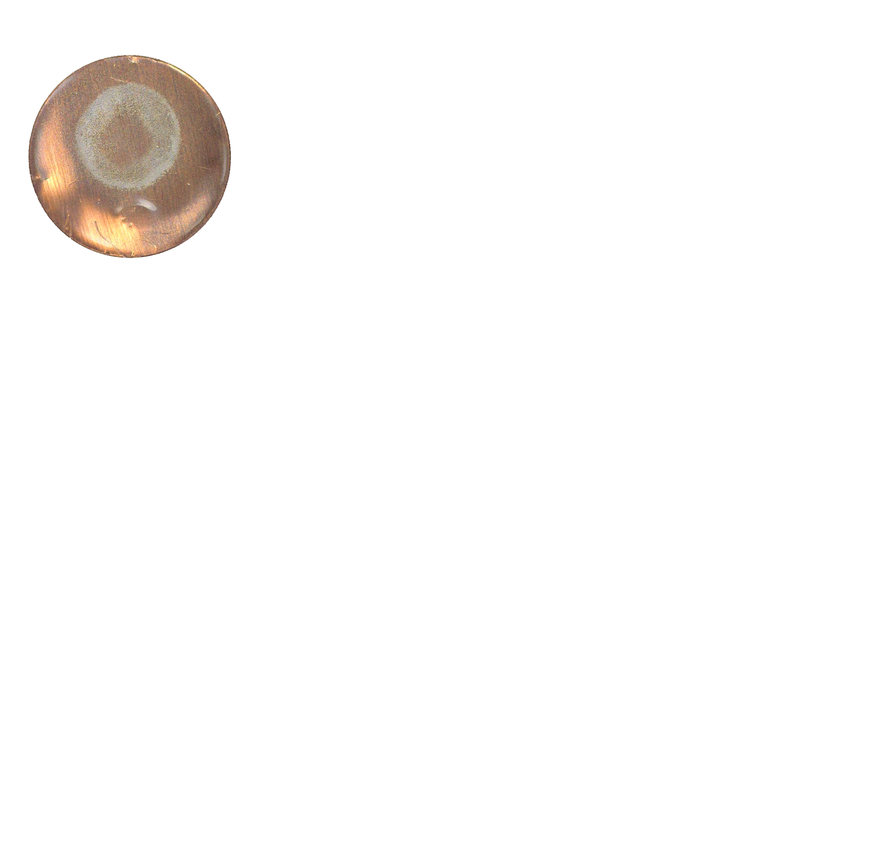
Pressure effects

Slide 48
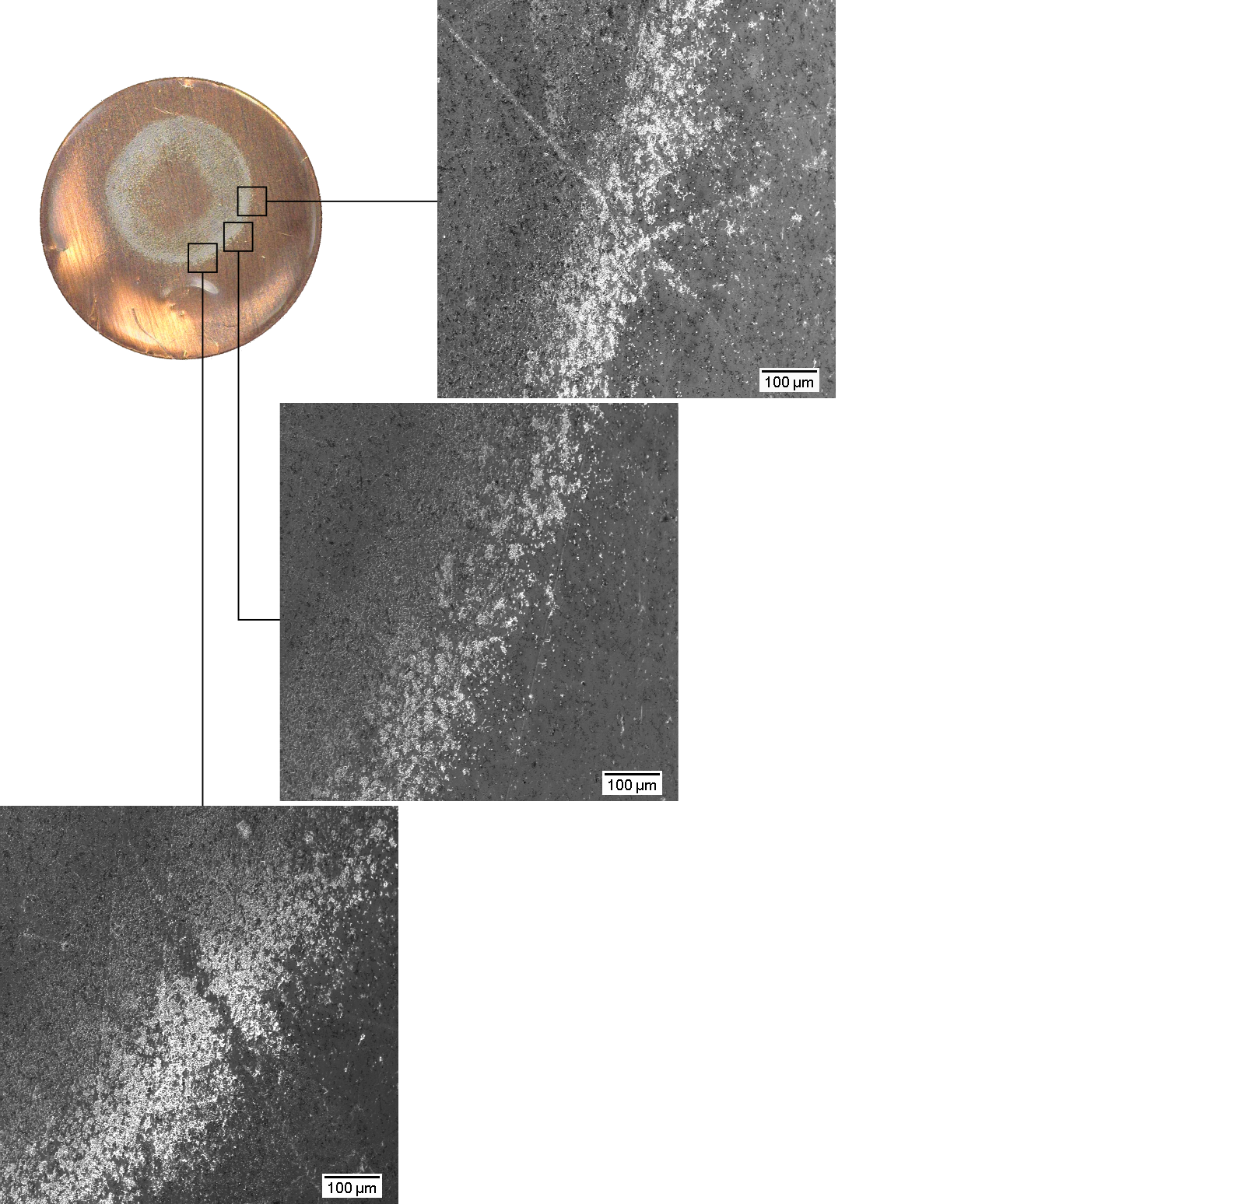
Pressure effects

Slide 49
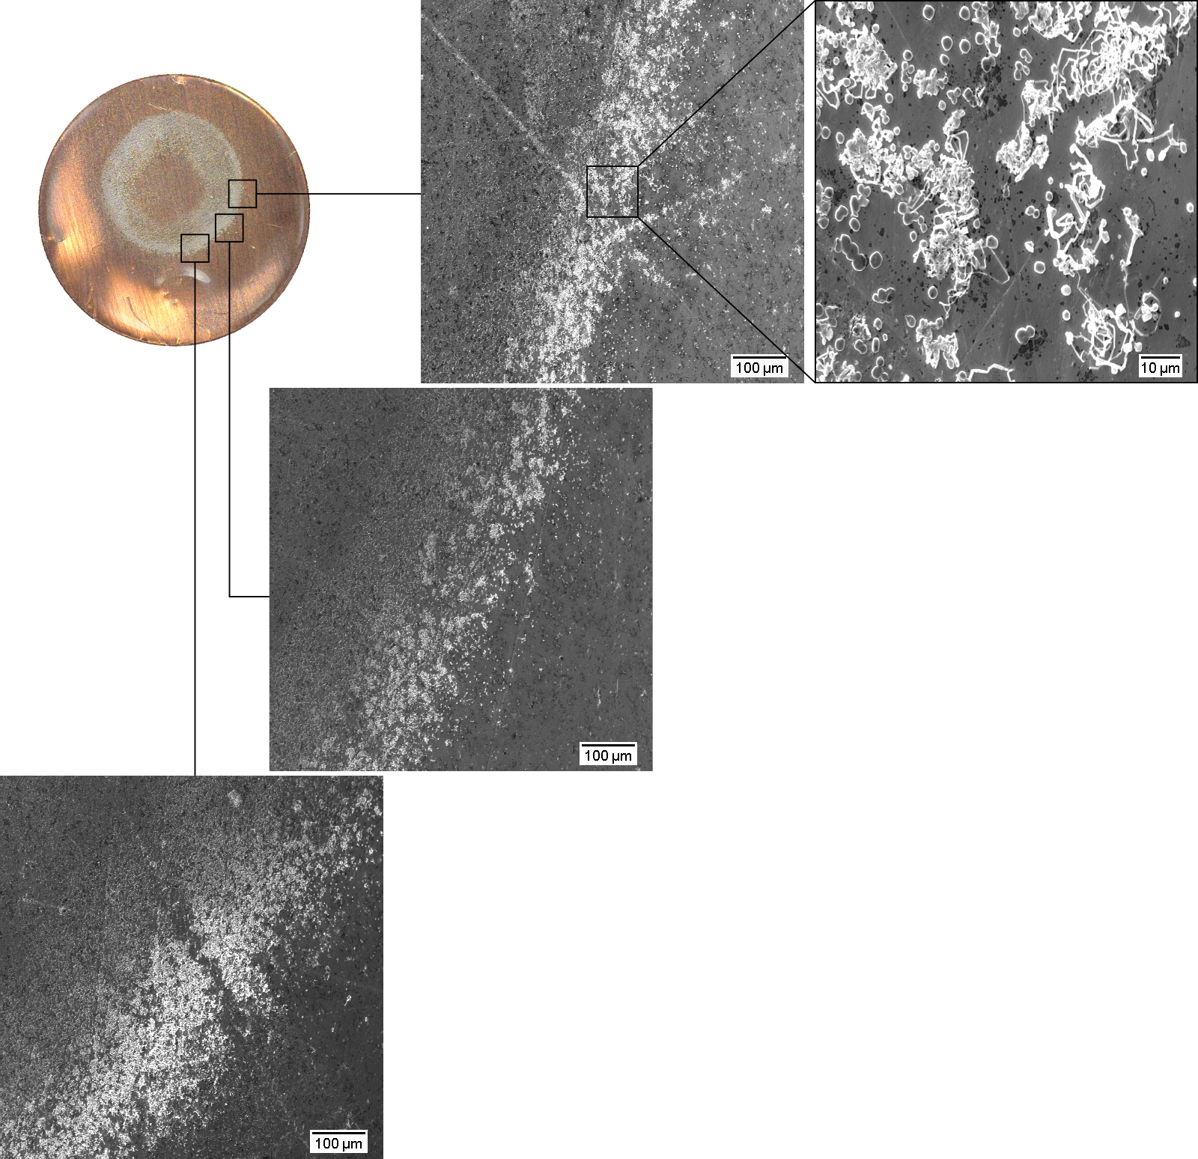
Pressure effects

Slide 50
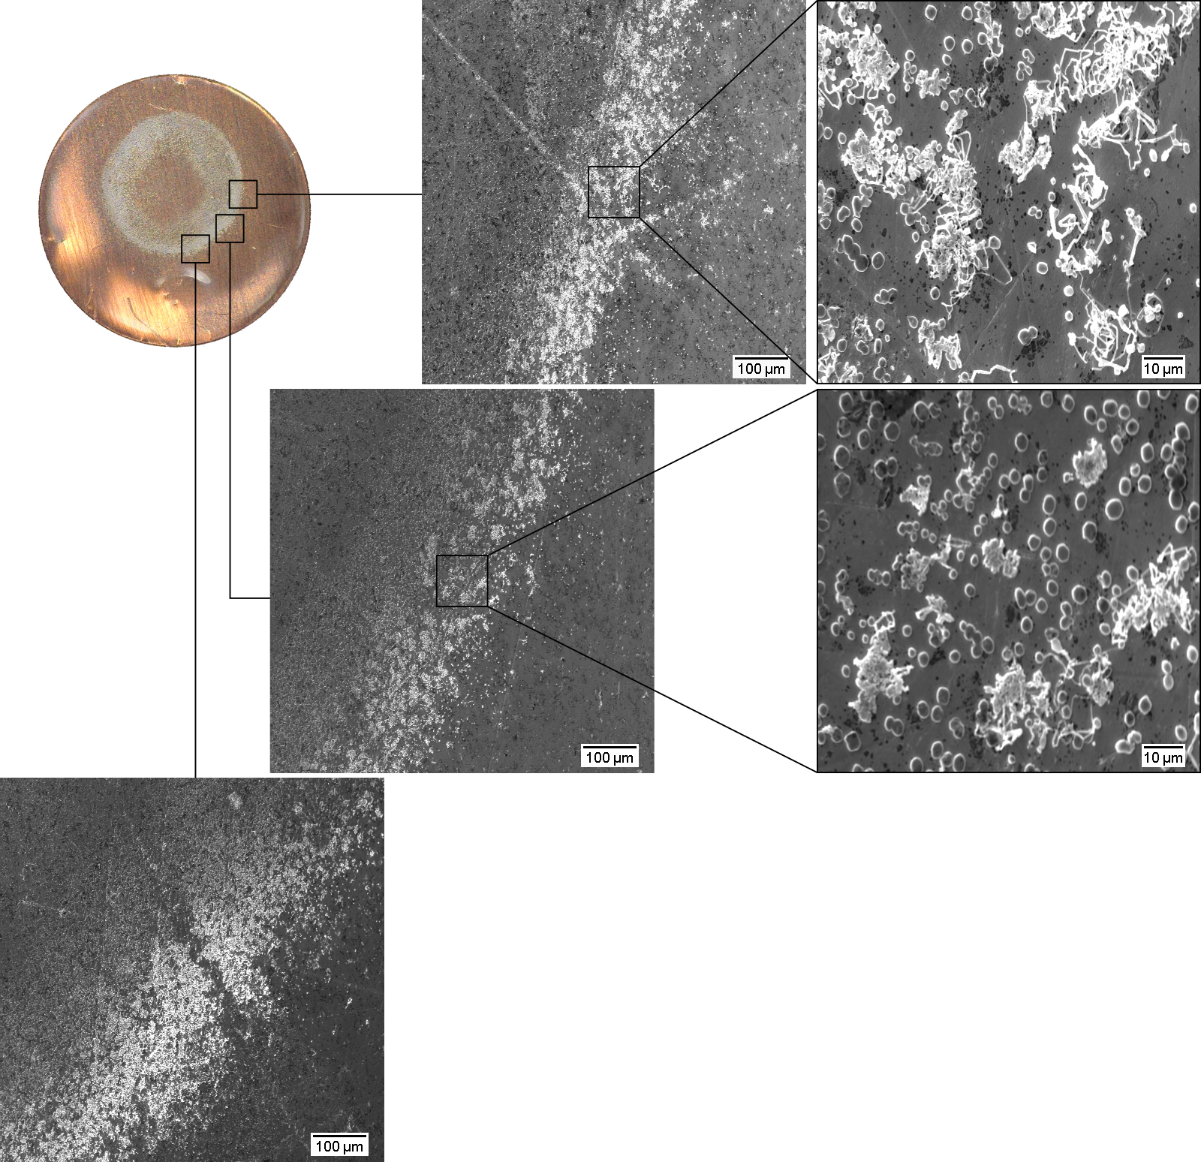
Pressure effects

Slide 51
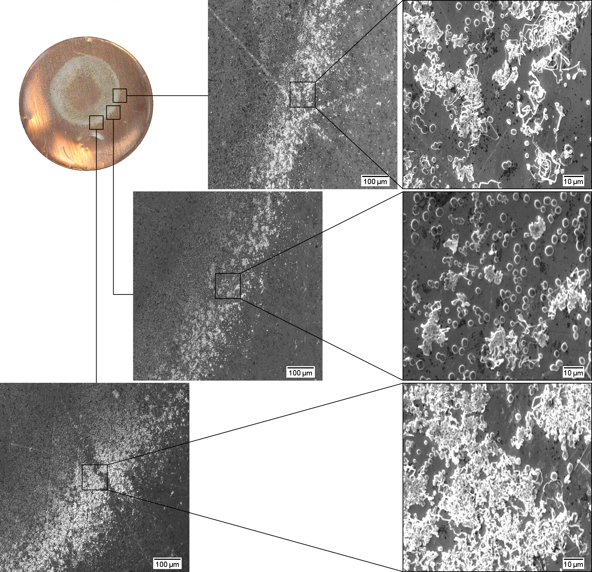
Pressure effects

Slide 52
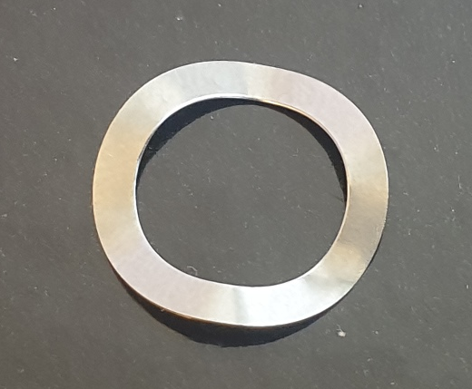

Pressure effects

Slide 53

Pressure effects

Slide 54

Pressure effects

Slide 55
Conclusions
To induce more instantaneous or more progressive nucleation, σ can be tuned.
The surface must be properly passivated, as it affects the nucleation peak and thus the nuclei distribution (r and N).
Uniform pressure between the electrodes is essential to achieve uniform deposition.

Slide 56
Thank you for listening!

Slide 57
//Lägg in fler plots här efter på större charge och andra figurer som Isak kanske kommenterar

Slide 58
Electrochemical deposition of lithium on copper
Gottfrid Olsson
2024-05-29

